Slide 1


Your DevOps Rollout is stalling!
Here is WHY…
DEVOPS ONLINE SUMMIT
NORTH AMERICA
February 11 @ 4 PM
Budget you received
What you hoped / expected
Gaps
Frustration
Budget Cuts
How it probably went…
Mindset
Education
Technology
In retrospect what it actually requires…
… & Now HOW to Course-Correct it.
Adam Kruszynski | adam@valuetransformed.com | Connect via LinkedIn
Notes:
https://youtu.be/G6RNv9D1kGo

Slide 2
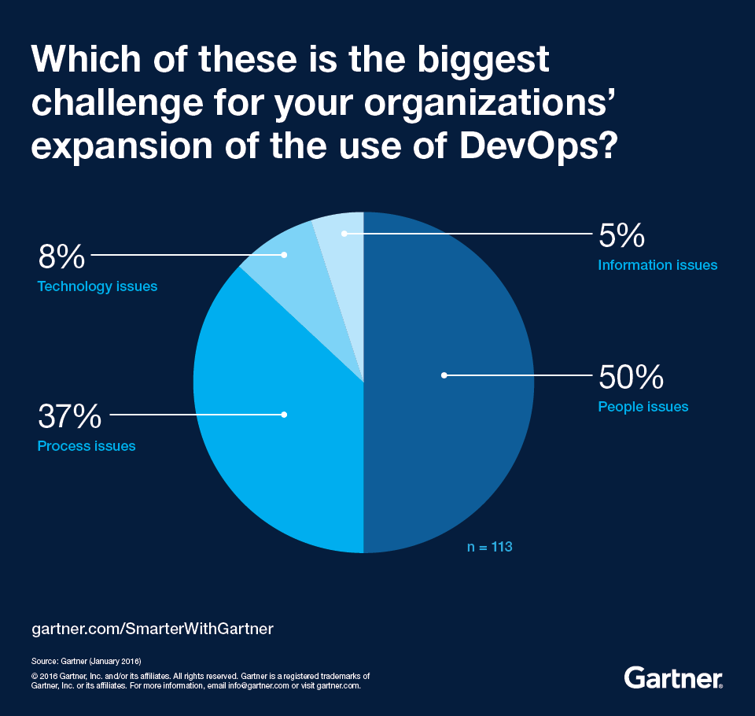
75% Failure Rate
In 2018 & most recent May 2020 “The Secret to DevOps Success” Gartner projected that 75% of DevOps initiatives will fail to meet expectations due to issues around organizational learning & change [management]
Notes:
https://www.gartner.com/smarterwithgartner/the-secret-to-devops-success/
https://devops.com/the-top-5-ways-devops-fails-and-how-to-prevent-them/
https://www.gartner.com/en/conferences/apac/infrastructure-operations-cloud-india/gartner-insights/swg-the-secret-to-devops-success

Slide 3
Is this how your DevOps initiative feels?
Budget you received
What you hoped / expected
Gaps
Frustration
Budget Cuts
How it probably went…
Mindset
Education
Technology
In retrospect what it actually requires…

Slide 4
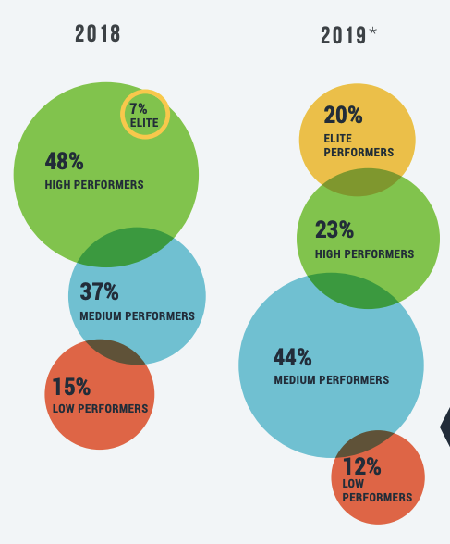
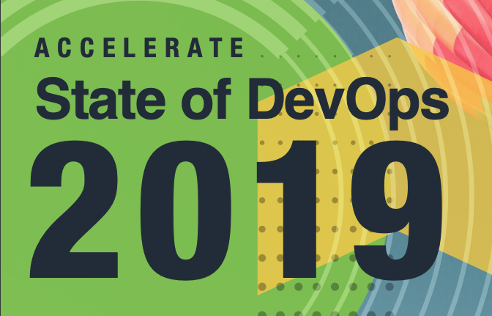

We are NOT here to COMMISERATE…
We are here to face
our biggest mistakes
& to LEARN from them

Slide 5
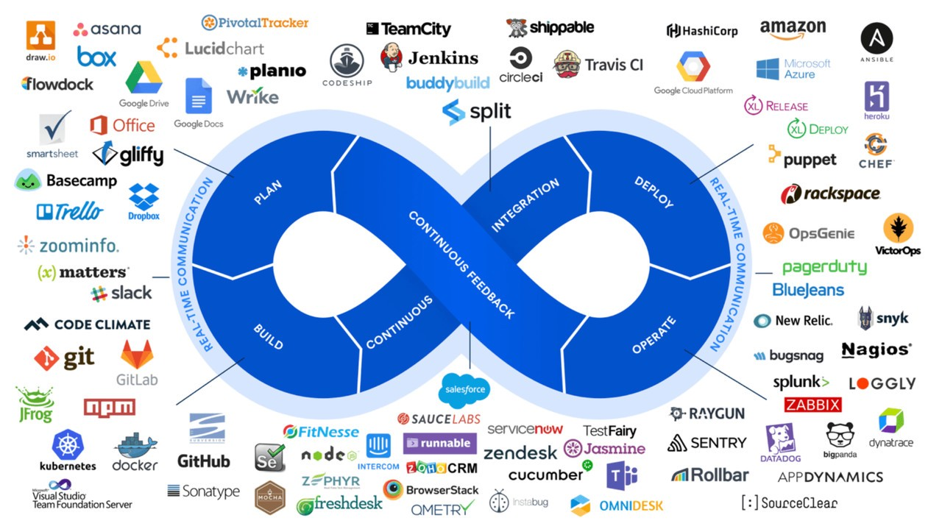

Slide 6

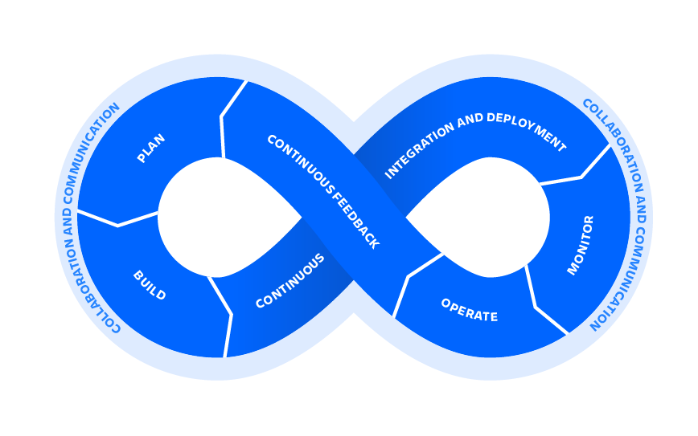
Product
Innovation &
Transformation
Org. Culture
Changes
Staff Fears
& Beliefs
Growing
Tech Debt
Fit for Purpose
Transformation
Challenges Recruiting
& Retaining Talent
Lean Agile
Transformation
Customer Centricity
& Experience
Design
Digital
Transformation
CapEx
vs OpEx
Cyber
Terrorism
Org.
Politics
Evolving Org.
Processes & Practices

Slide 7


We are great PROBLEM solvers…
yet ill-equipped to solve OURSELVES
Notes:
Architect and enable low-risk releases. Establish fast recovery, fast reversion, and fast fix-forward.

Slide 8


We embrace the familiar TECH / CODE yet resist the unfamiliar CULTURE & HUMAN
Notes:
We choose server farms over meeting rooms
Emails over face-to-face conversations
Code branching over relationships

Slide 9
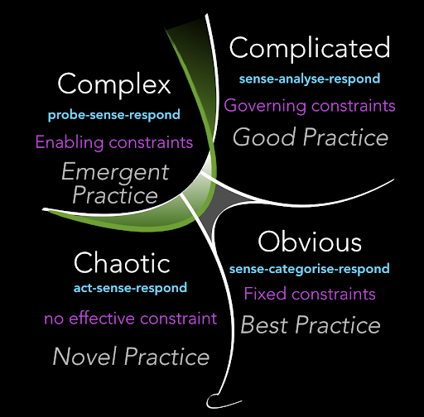
We believe DevOps is predictably COMPLICATED
not unpredictably COMPLEX or CHAOTIC
Notes:
Cynefin framework is based on systems theory, complexity theory, network theory and learning theories.

Slide 10


We focus DevOps on our IT AGENDAS, not real BUSINESS & CUSTOMER needs

Slide 11


We assume the EXECUTIVE BOARDROOM not the DOERS drive DevOps Initiatives

Slide 12

How do we course-correct
our DevOps initiatives?
Insightful
Principles
Pragmatic
Practices
Notes:
Establish fast recovery, fast reversion

Slide 13
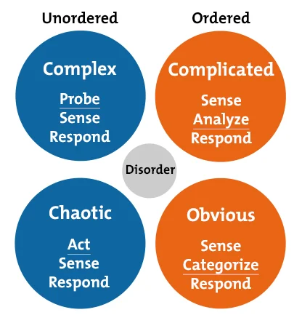
Fundamental premise: DevOps Initiatives are Complex / Chaotic (Cynefin Framework)
UNPREDICTABLE
Probe, Test,
& Experiment
LEADERS
Focus on WHY
Empower Doers
Guide & Coach
Remove Delays
PREDICTABLE
Analyze, Plan,
& Architect
MANAGERS
Focus on HOW
Manage Doers
Approval Gates
Best Practices
Notes:
Cynefin framework is based on systems theory, complexity theory, network theory and learning theories.

Slide 14

DevOps is a HOW - Don’t Suboptimize for IT!
Optimize for WHY - Business & Customer Needs
Up

Slide 15
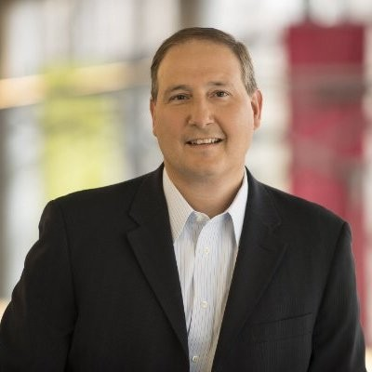

START
listening & learning which BUSINESS OPPS. could DEVOPS
accelerate
STOP
convincing stakeholder that DEVOPS
will address big BUSINESS CHALLENGES
John Marcante CIO
“Deliver business value at Startup speed…”
Notes:
For Vanguard CIO John Marcante, DevOps plays a critical role in his team’s shared goal: to “deliver business value at startup speed,” even at a global financial services giant. His team is “embracing DevOps principles in order to minimize the time between when code is checked into our version management system and when a feature is available to our clients,”
https://enterprisersproject.com/devops
https://enterprisersproject.com/article/2016/11/transformation-model-enables-vanguard-it-increase-speed-and-innovation

Slide 16

Don’t Lead with Great New Tech Solutions!
Lead with Great Culture & Change Leaders

Slide 17
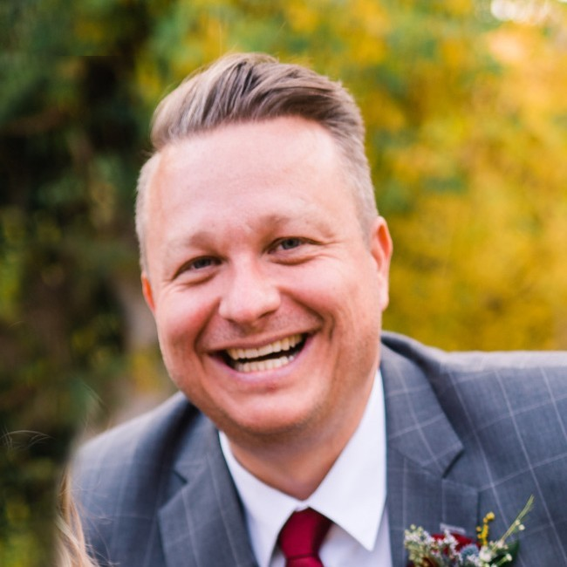

START
hiring & promoting LEADERS
for their CULTURE
CHANGE EXPERIENCE
STOP
hiring & promoting MANAGERS
for their
TECHNICAL DOMAIN EXPERTISE
Mike Rasmussen, VP
“Building a better
hen house…”
Notes:
https://www.pluralsight.com/blog/teams/devops-can-t-work-without-a-culture-of-trust-with-mike-rasmussen

Slide 18

Don’t Manage DevOps Transformations!
Inspire, Empower, & Better Equip Doers

Slide 19
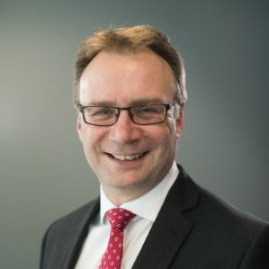

START
creating TRUST by removing
their biggest OBSTACLES & asking them
how you could IMPROVE
STOP
creating FEAR
by giving teams unrealistic TARGETS & telling them how they need to IMPROVE
Richard Herbert CIO (now retired)
“I believe that if we empower our teams and trust them, they will repay our trust many times over.”
Notes:
'I believe that our teams come to work every day to do the best job they can.
I believe that if we give our teams ambitious goals and let them figure out how to reach them, they will achieve things we never expected.
I believe that if we empower our teams and trust them, they will repay our trust many times over.
I believe that it is possible to go faster and break less - and we break less because we go faster.
In GB&M, we express these beliefs by setting every team the goal to double, half and quarter every year: double the frequency of releases, half the number of low impact incidents, and quarter the number of high impact incidents.'
https://www.linkedin.com/pulse/double-half-quarter-lesson-from-book-richard-david-knott/

Slide 20
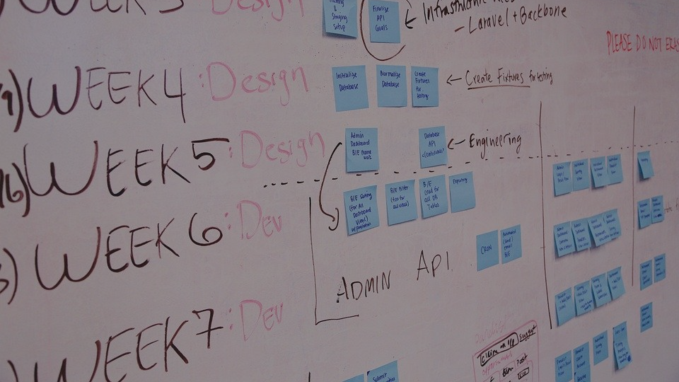
Don’t Expect a Grand DevOps Masterplan!
Transform through Iterative Exploration

Slide 21
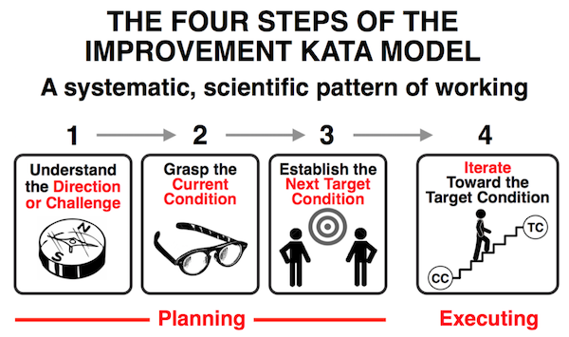
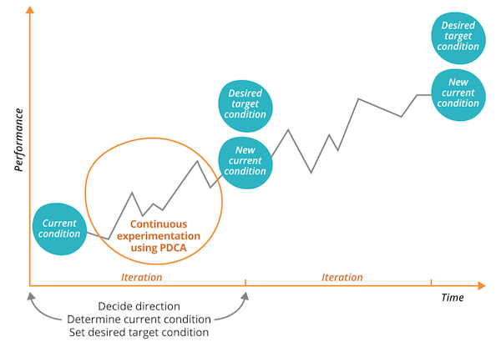
START
embracing the OPPORTU-NITY of
newly emerging OPTIONS
STOP
expecting PREDICT-ABILITY
of uninformed rigid PLANS
Notes:
https://cloud.google.com/solutions/devops/devops-culture-transform

Slide 22

Thank You
Questions?
Adam Kruszynski | Business Transformation Lead
ValueTransformed.com | adam@valuetransformed.com

Slide 23
Extra Slides
As Needed

Slide 24
QUICK INTRO @ VALUE TRANSFORMED
In a highly disruptive world (context)
We empower organizations (who)
To elevate customer value (why)
By rapidly evolving culture & practices (how)

Slide 25

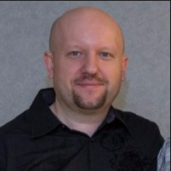






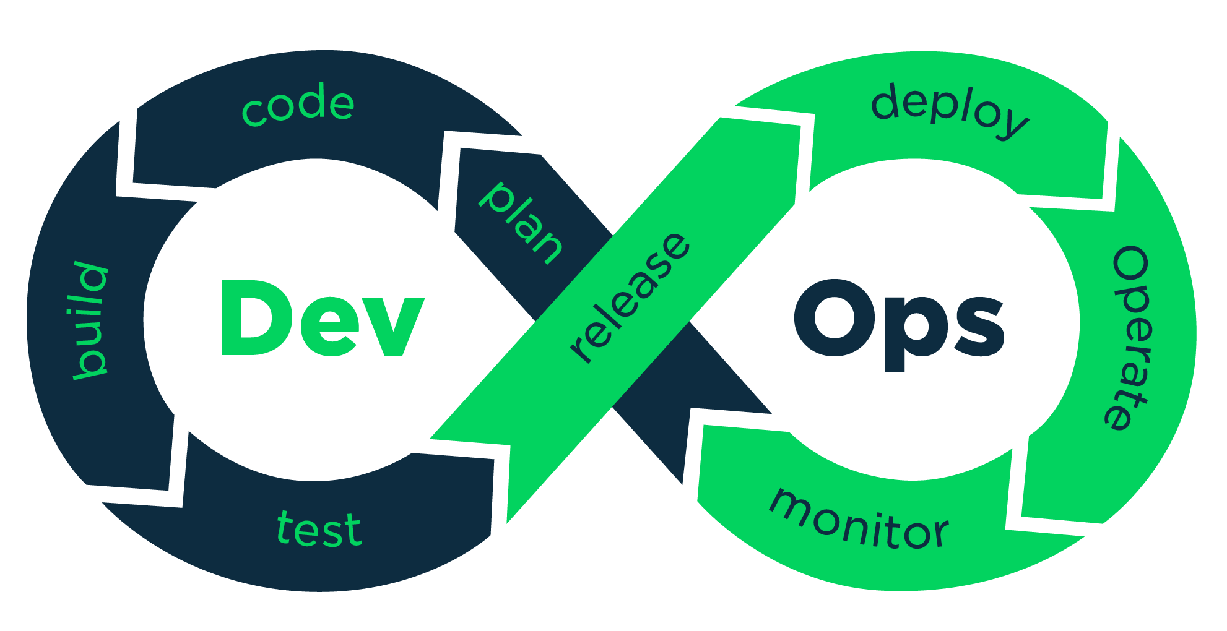
Relevant Experience
■ 12+ years of Digital Transformation
■ 14+ years of Enterprise Lean Agile
■ 6+ years of DevOps Transformation
■ 12+ years of Consulting Experience
■ 15+ years of Coaching & Training
■ 4+ years as Certified DevOps Instructor
■ 8+ years of Software / Web Development
■ 25+ years of Technology Experience
Business
Transformation Expert
Adam Kruszynski
https://www.linkedin.com/in/kruszynskiadam/

Slide 26
FINANCIAL
PRODUCT
AGILE TRANSFORMATION
FORCED TOOL UPGRADES
ORG. CHANGES
MARKET SHIFTS
TECHNICAL DEBT
PRODUCT STRATEGY
SOCIO-ECONOMIC CHANGES
ACTIVITY
TIME

Slide 27
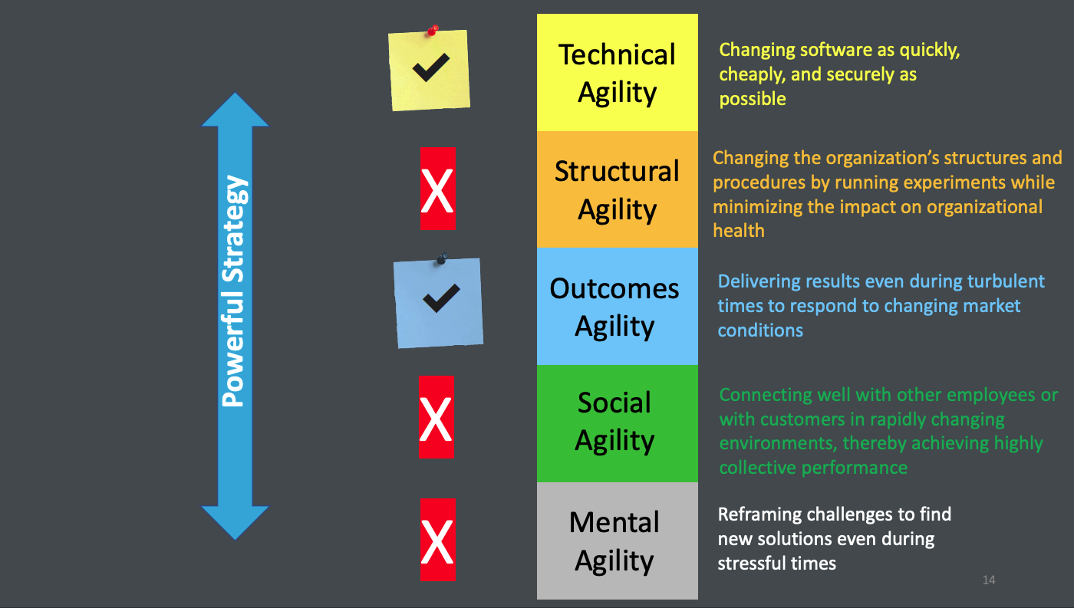


Slide 28
