Slide 1

Adam Kruszynski
World Vision Canada
Notes:
Image Credit https://media.licdn.com/mpr/mpr/AAEAAQAAAAAAAAcwAAAAJDA1ODhmMWZmLTczZDUtNGMyYS1hNDM0LTM0ZmVlMDY3NWNjYQ.jpg

Slide 2
Let’s start with a few questions…
How many of your organizations / companies are currently going through Digital Transformation?
How many of you here have some aspect of
Digital Transformation as part of your role?
How many of you are on the Marketing side? IT side? Business/Finance side?
Since so many of you are involved in Digital Transformation, can you describe to me what it is?

Slide 3
What is this thing we call
Digital Transformation?

Slide 4
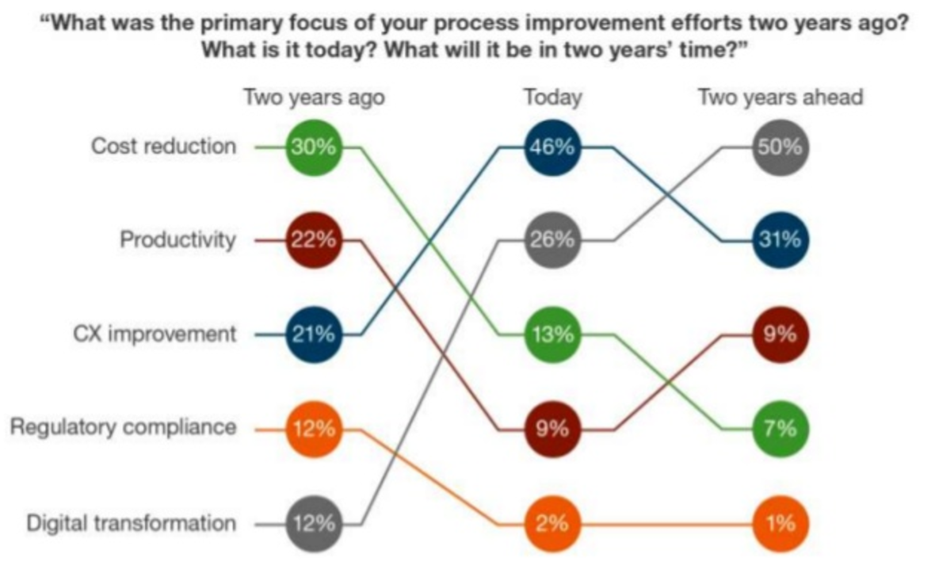
We know we must focus on it…
… and for many of us
it is a top priority…
50
26
12
Source: Forrester Digital Business Automation Survey (Q2 2016)
Notes:
https://www.slideshare.net/Bizagi/why-digital-business-automation-is-vital-to-the-customer-experience-featuring-forrester-research

Slide 5
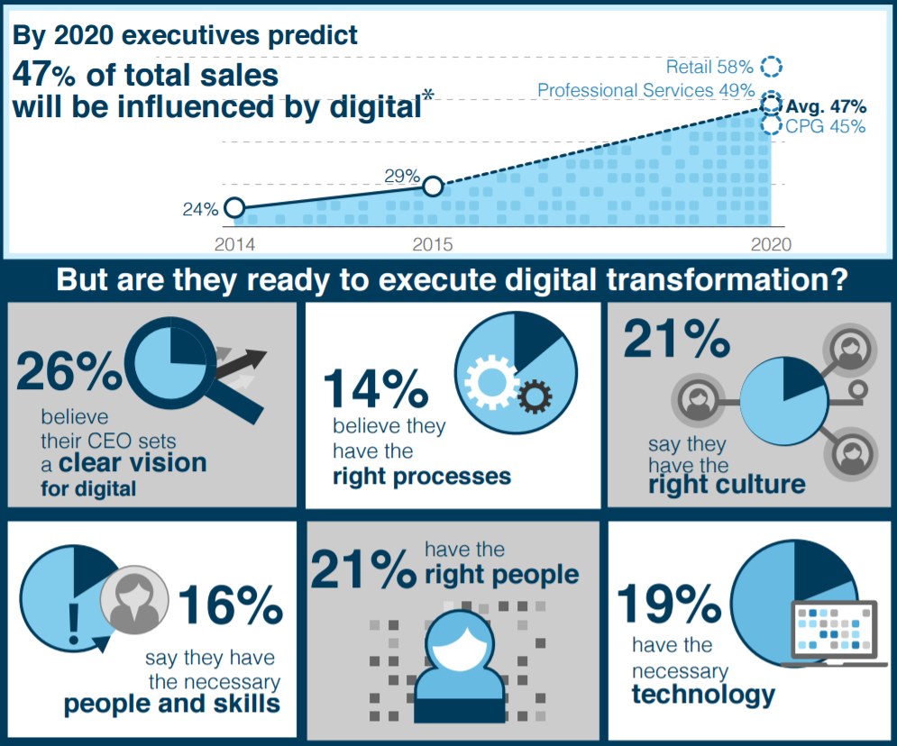
We know its critical to our success…
… yet ~80% of us feel they are NOT prepared to execute it!
Source: Forrester the State
of Digital Business (2016)
Notes:
https://www.forrester.com/staticassets/marketing/blogs/ForresterInfographicDigitalBusinessNigelFenwick18.pdf

Slide 6
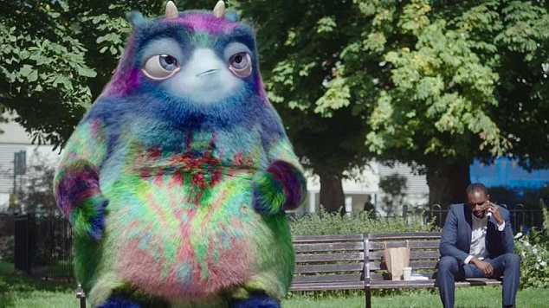
… but do we really know what it is?
Notes:
Story: Do you ever have difficulties introducing yourself… explaining what you do… your title is confusing
I’ve always been struggling to do this so I developed a more relatable way to talk about what I do
So I went to a birthday and sat beside another introvert husband that didn’t really want to be there…
And I got this idea from a UK commercial by Department of Work and Pensions
I help people understand what
Image credit: http://www.dailymail.co.uk/news/article-3282437/It-s-Ministers-Government-dreams-bizarre-animal-supposed-people-think-pensions.html

Slide 7
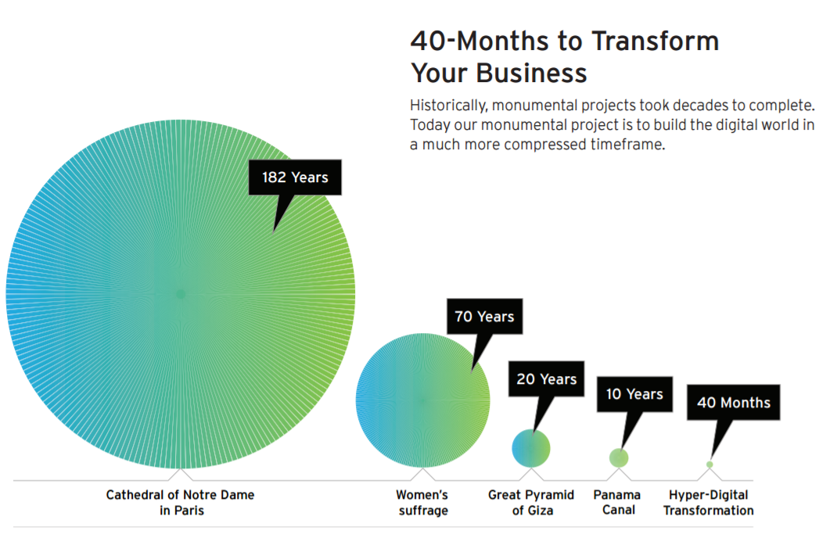
Digital Transformation = Hyper-Change Management In Our Rapidly Evolving
Digital World
Source: Cognizant 40 Months of Hyper-Digital Transformation 2016
Notes:
I would like to propose a definition…
But let’s make this more fun
https://www.cognizant.com/FoW/twa-hyper-digital-transformation-codex2478.pdf

Slide 8
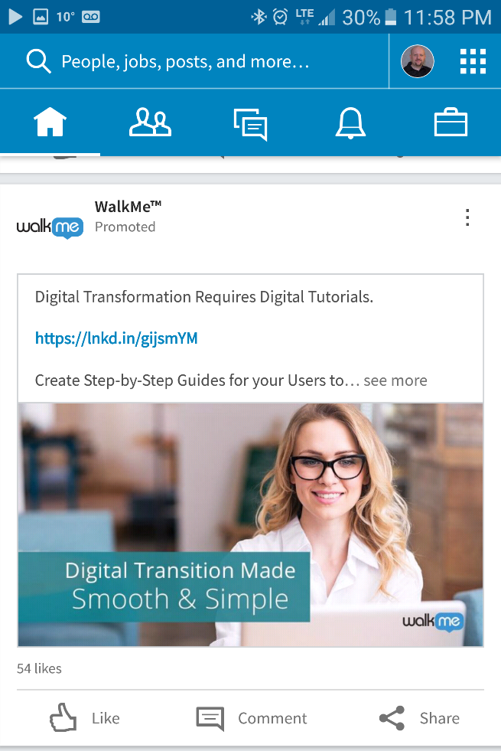
Myth 1: You can tame this creature by adopting some type of solution or technology.
Notes:
No there is not magic bullet. There is no single approach, no single software, no single magical insight.

Slide 9
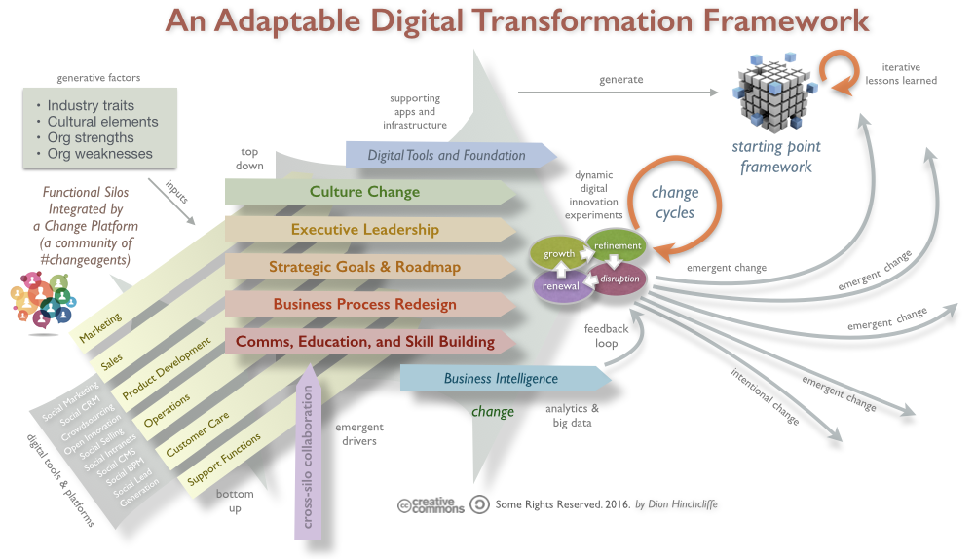
Myth 2: You can handle this creature
by yourself.
Source: Dion Hinchcliffe / Creative Commons
Adaptable Digital Transformation Framework 2016
Notes:
This is called an Adaptable Digital Transformation Framework
No! You will need help to look outside of yourself, change what you believe, and evolve how you do business.
https://dionhinchcliffe.com/2016/10/20/in-digital-transformation-culture-change-goes-hand-in-hand-with-tech-change/

Slide 10
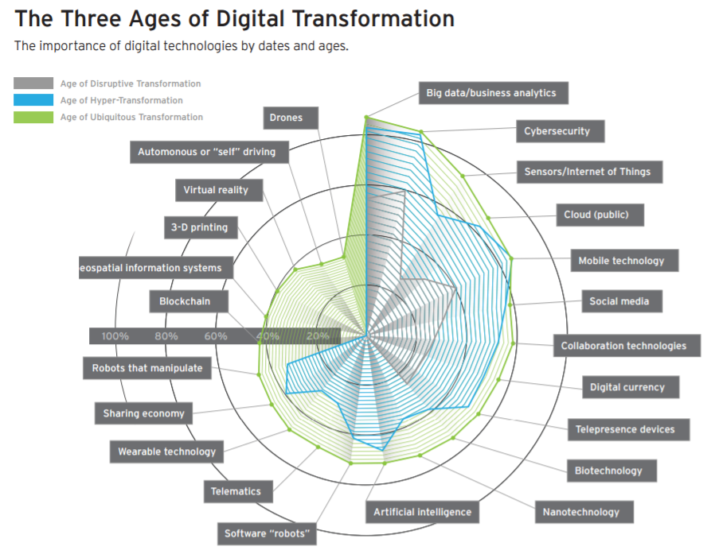
Myth 3: After you subdue the creature…
it will go away and leave you in peace.
Source: Cognizant 40 Months of Hyper-Digital Transformation 2016
Notes:
Nope. This creature is moving in and living in your office everyday… but that’s a good thing!
Another way to think of these stages is (1) adaptation (2) innovation (3) integration
https://www.cognizant.com/FoW/twa-hyper-digital-transformation-codex2478.pdf

Slide 11
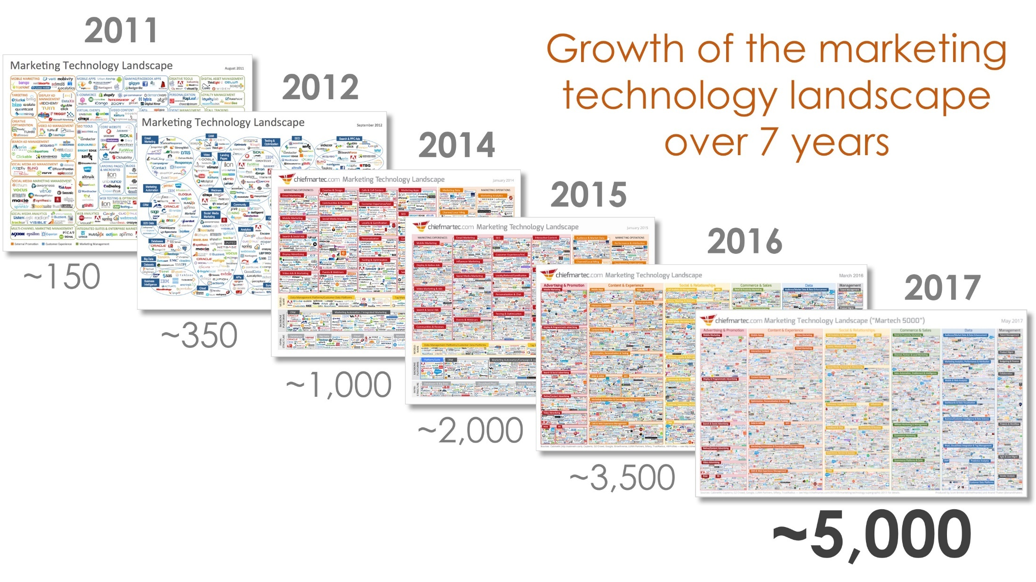
Truth: Growth Rate
Source: Scott Brinker | Chiefmartec.com
Marketing Technology Landscape Supergraphic 2017
Notes:
Here is some quantifiable proof of an unquantifiable shift we call the Digital Transformation
http://chiefmartec.com/2017/05/marketing-techniology-landscape-supergraphic-2017/

Slide 12



Truths: This Creature Keeps Changing…
Digital Transformation is Iterative in Nature
This is how simple we wish it was…
This is what the inconvenient
but awesome truth is…
Buy Tool or Technology X
People
Process
Tech
So this is what tech sales rep tell us…
Just buy my tool / technology and it will solve all your problems…
Notes:
Question: How many of you believe you are well on your way understanding and practicing the iterative reality?
Do you plan to keep your current CRM platform for more than 5 years
Are you doing mobile first design?
Does your department allocates less than 7% on staff re-training
Do you have a senior business stakeholder responsible for customer experience / customer journeys
Does your company doesn’t have active culture change programs for your staff, especially ones you need to transition

Slide 13
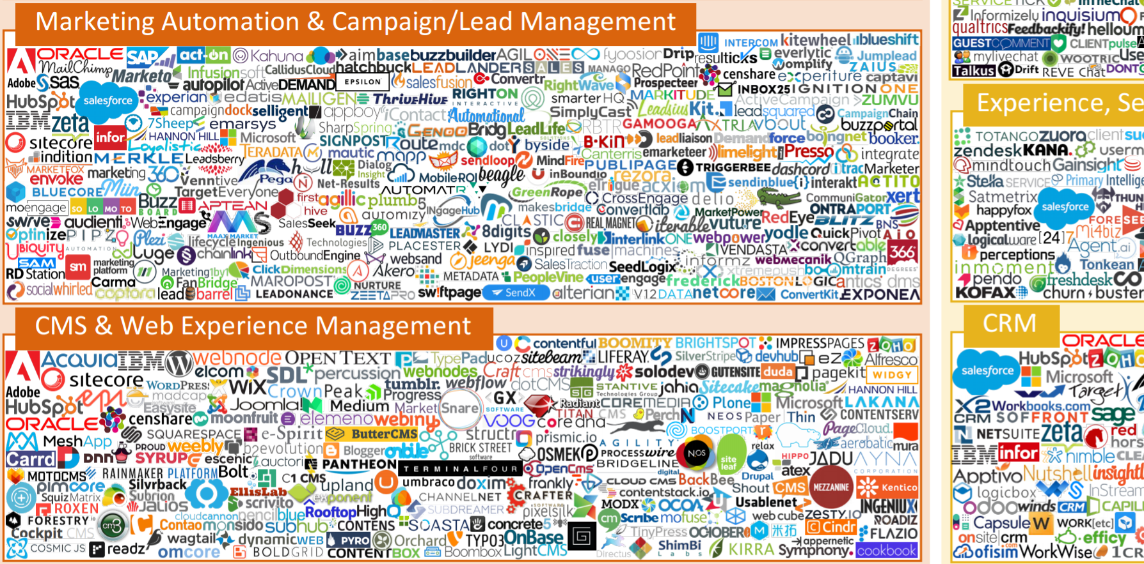
Truth: Growth Rate
Source: Scott Brinker | Chiefmartec.com
Marketing Technology Landscape Supergraphic 2017
Notes:
http://chiefmartec.com/2017/05/marketing-techniology-landscape-supergraphic-2017/

Slide 14
Truths: We Are All Learning How This Creature Behaves
Digital Transformation Requires True Collaboration
Traditional predictable ecosystem
Disrupted rapidly evolving ecosystem
Marketing
Predict ROI
Finance / BI
Technology
Marketing
Insights
Holistic Collaboration
& Shared Strategy
Finance
Opportunity
Technology
Streamlined
Production
Process
Hierarchy
Created
Efficiency
Notes:
Traditional = Profit Requires Efficiency > Efficiency Requires Scale > Scale Requires Specialization > Specialization Results in Complexity
Evolving = Success Requires Rapid Adaptation > Adaptation Requires Frequency (not scale) > Frequency Requires Collaboration > Collaboration Requires Generalization (not Specialization)

Slide 15
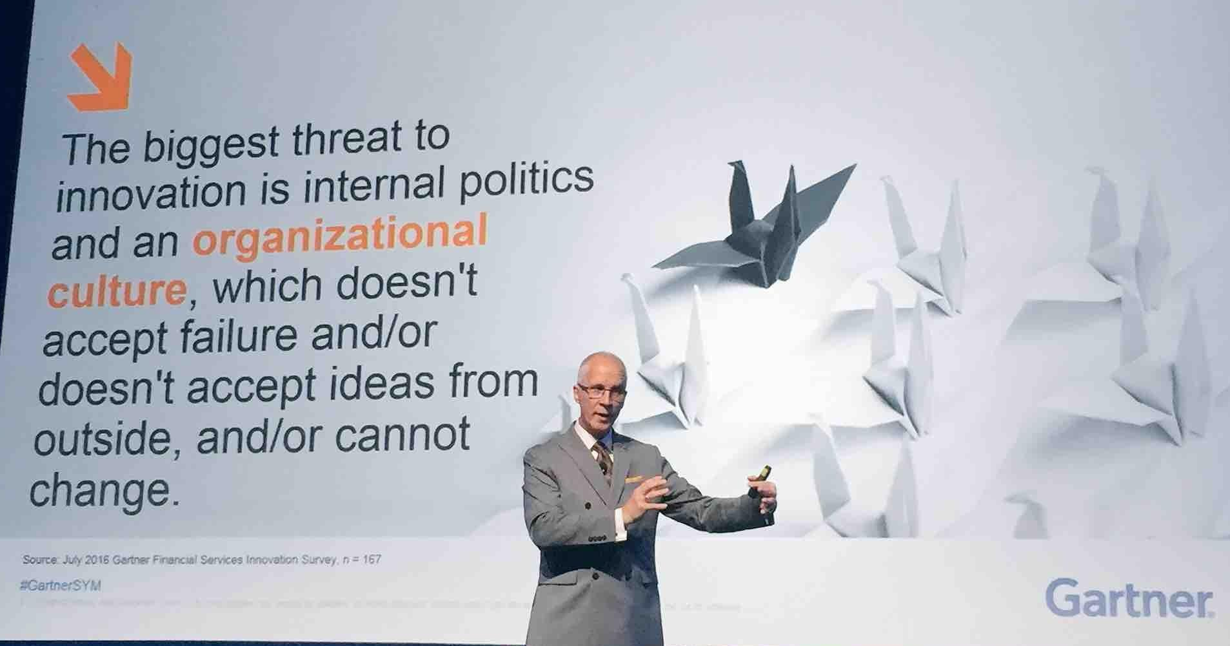
Truths: This Creature Will Change You Completely…
Digital Transformation is a Different Way of Being (not doing)
Source: Gartner 2016 Symposium
Notes:
Culture is consistently the biggest challenge… what does that tell you… it’s not simply about process or tech… it’s about changing how we think and behave… it’s about a fundamental change to how we work
http://www.gartner.com/events/na/orlando-symposium

Slide 16
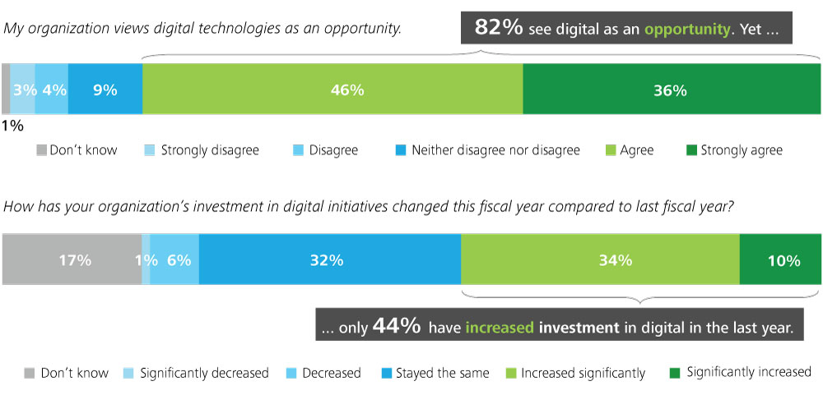
Advice: Start by simplifying… significantly!
Source: Deloitte University Press | DUPress.com
Notes:
How much? 20-30% You will need the time / money… and it will be easier to change when you’re simpler
Profit: Focus on what drives value / profit. Reduce anything doesn’t
Non-Profit: Focus on what has the biggest impact and receives highest funding and continues to grow… reduce traditional marketing budgets for digital ones
https://dupress.deloitte.com/dup-us-en/topics/digital-transformation/digital-transformation-in-government.html

Slide 17
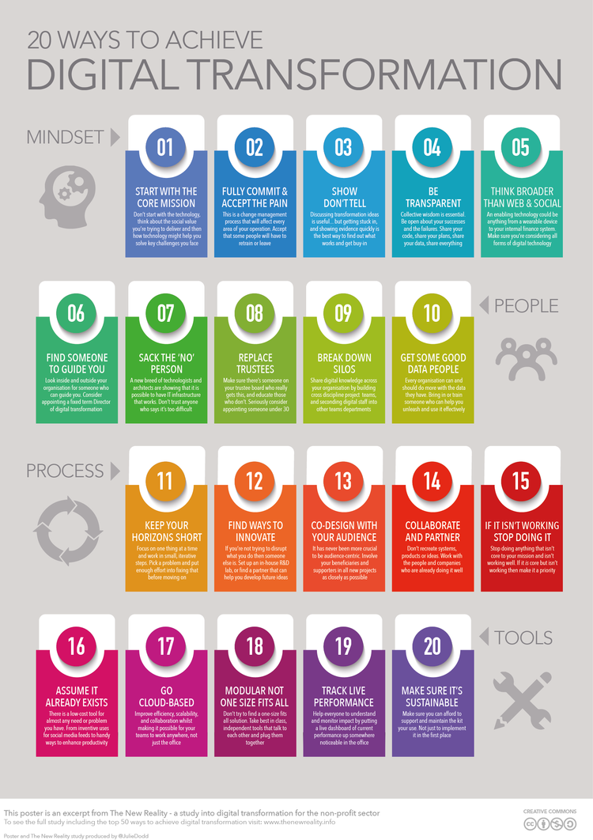
Advice: Anchor it to your purpose / cause!
Source: The New Reality
20 Ways to Achieve Digital Transformation
Notes:
Profit:
Non-Profit: The biggest advantage a non-profit has during any transformation… is a genuine compelling & shared cause propelling it.
http://thenewreality.info/poster

Slide 18
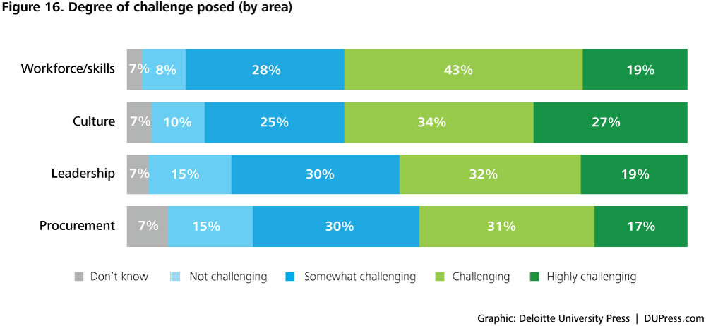
Advice: Culture & Skills Before Tech
Source: Deloitte University Press | DUPress.com
Notes:
Profit:
Non-Profit:
https://dupress.deloitte.com/dup-us-en/topics/digital-transformation/digital-transformation-in-government.html

Slide 19
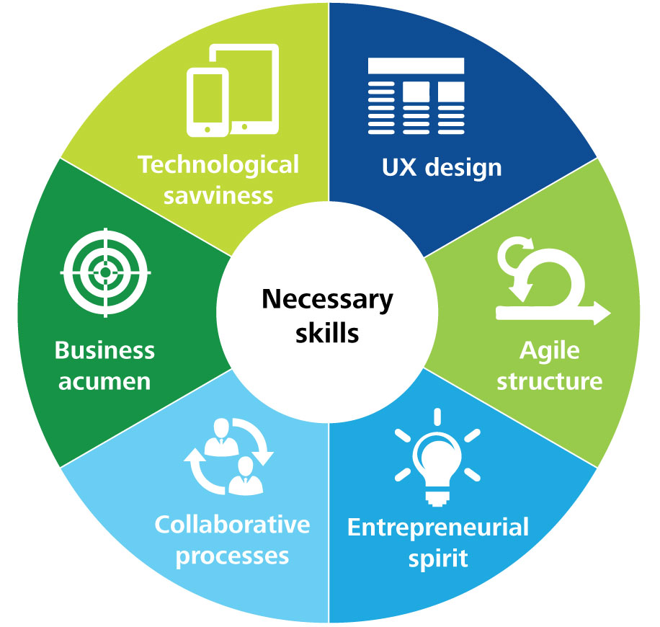
Advice: Evolve Your Processes
Source: Deloitte University Press | DUPress.com
Notes:
You need an operational model that embraces ambiguity, innovation, and change
https://dupress.deloitte.com/content/dam/dup-us-en/articles/digital-transformation-in-government/DUP1081_Figure18.jpg

Slide 20
Advice: Get Help From Trusted Partner(s)
Source: Forrester the State
of Digital Business (2016)
Notes:
Profit: Consulting firms (like Oracle, Accenture, and more)
Non-Profit: Digital Advisory Council (free)
Source: https://www.forrester.com/staticassets/marketing/blogs/ForresterInfographicDigitalBusinessNigelFenwick18.pdf

Slide 21
Advice: What to do if you failed / are failing?
Remember you’re in good company: 84% of companies fail in their Digital Transformation “… it’s because they're not prepared to change behavior” (Forbes 2016).
Remember you’re in good company: 84% of companies fail in their Digital Transformation “… it’s because they're not prepared to change behavior” (Forbes 2016).
Understand DT is NOT optional. Your customers will NOT suddenly accommodate your operational difficulties and wait for you to change (Nokia, Blockbuster, Kodak…)
Remember you’re in good company: 84% of companies fail in their Digital Transformation “… it’s because they're not prepared to change behavior” (Forbes 2016).
Understand DT is NOT optional. Your customers will NOT suddenly accommodate your operational difficulties and wait for you to change (Nokia, Blockbuster, Kodak…)
Reflect, adapt your approach, & repeat… until you succeed. Yes it’s expensive. Not doing it will cost you even more.
Source: Forbes “Why 84% Of Companies Fail At Digital Transformation” 2016
Notes:
https://www.forbes.com/sites/brucerogers/2016/01/07/why-84-of-companies-fail-at-digital-transformation/#78898acc397b

Slide 22

World Vision Canada Transformation Story

Slide 23
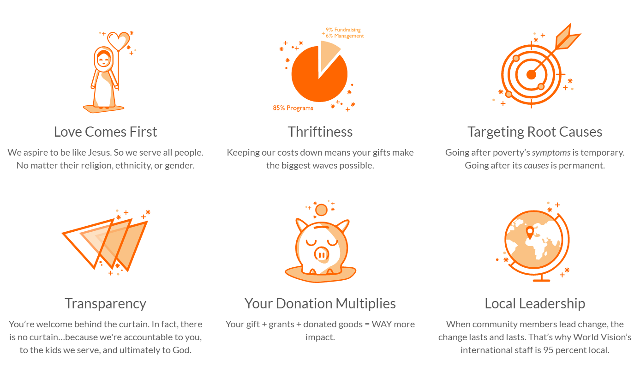
About World Vision Canada

Slide 24
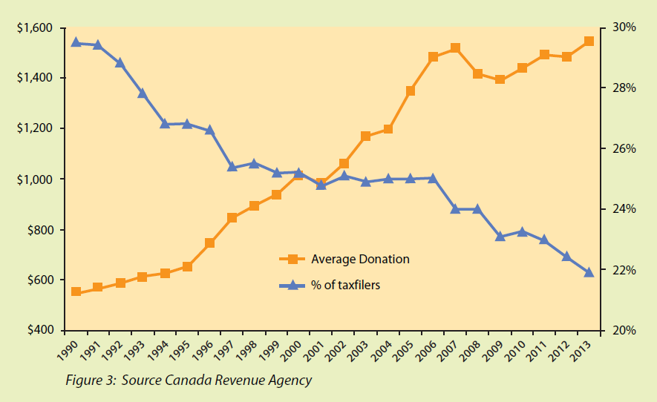
The money is coming from fewer people
Notes:
1. Everyone giving!
2. Who is giving?
Despite the occasional pulse, giving is increasing incrementally.
Year over year the total value of Canadian giving is essentially flat.
High net-worth people have a high propensity to give.
3. Who are they giving to?
Front runners are churches and religious organizations in a distant third and fourth is
education and human services respectively.
High net-worth people tend to give to educational organizations
4. Who are donors talking too?
There are 88,000 registered charities in Canada vying for your attention.

Slide 25
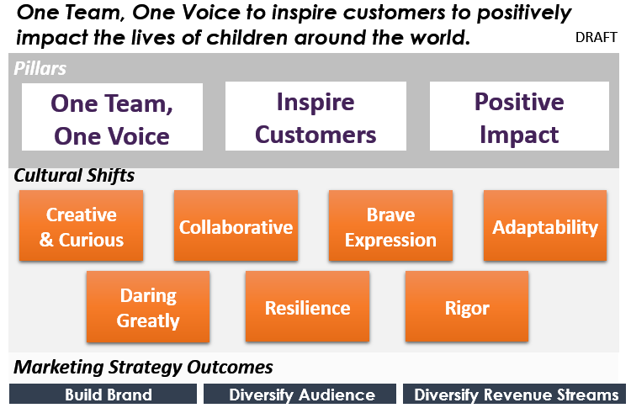
Our response – a cohesive strategy
Marketing Vision

Slide 26
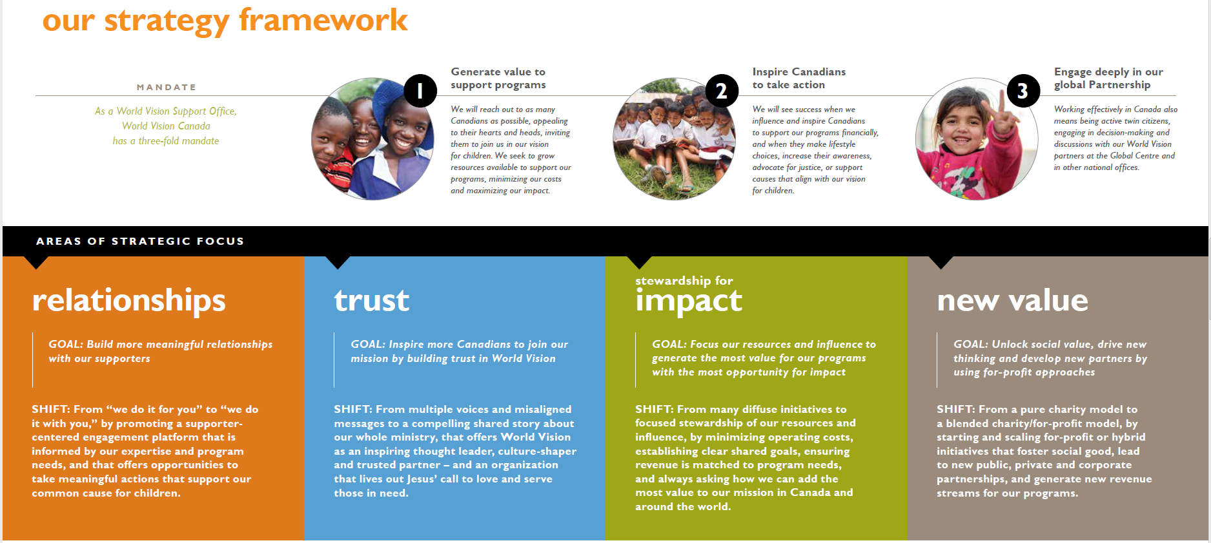
Shift from Product Centric to Customer Centric
Headline

Slide 27
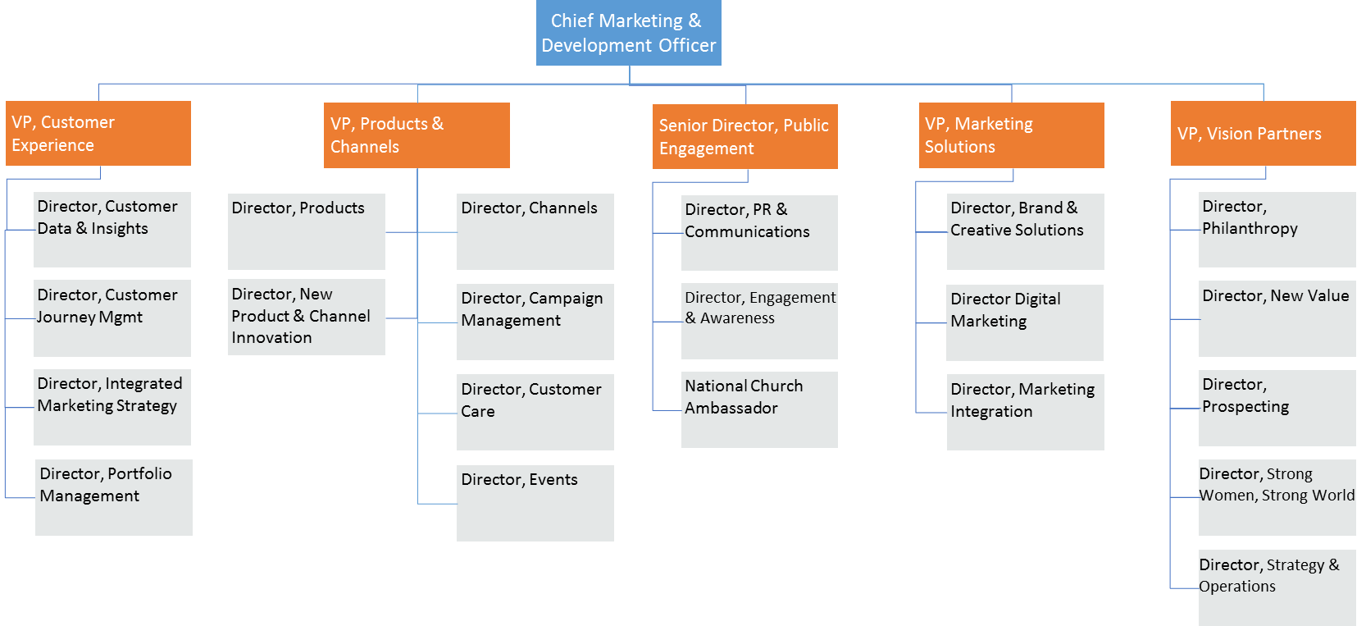
Significant Cultural And Structural Changes

Slide 28
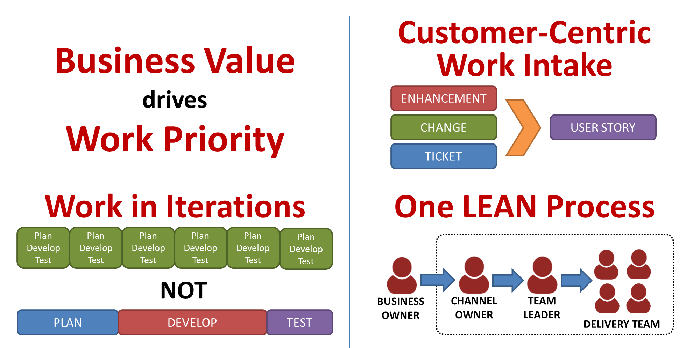
Shift from Traditional to Scaled Agile IT Model

Slide 29
Thank you!
Let’s continue the conversation…
Adam Kruszynski | Director of Technology Transformation
Adam_Kruszynski@WorldVision.ca
https://adamoutsidethebox.wordpress.com/ (download this deck)
https://www.linkedin.com/in/kruszynskiadam/

Slide 30
Extra Slides for Q&A

Slide 31
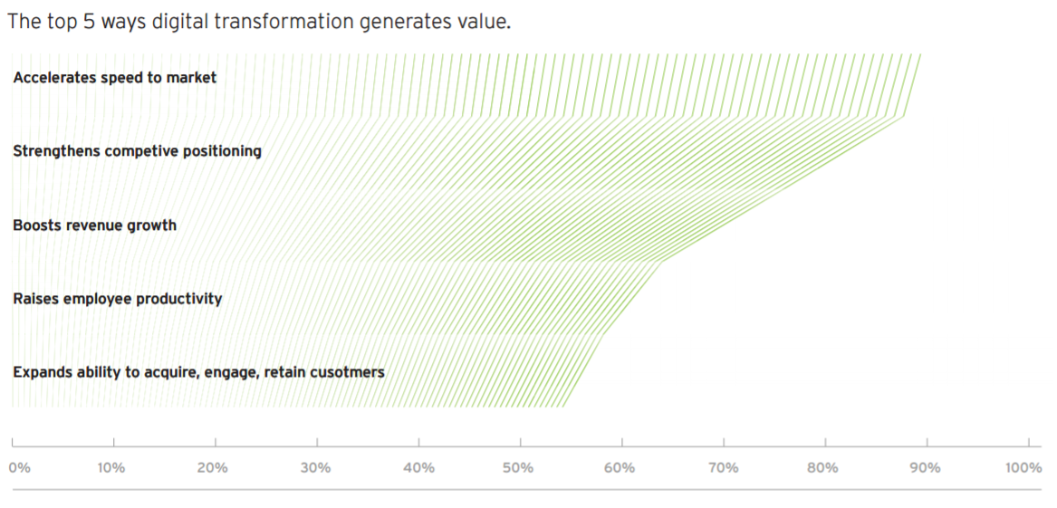
Q&A: Proven value of DT?
Source: Cognizant 40 Months of Hyper-Digital Transformation 2016
Notes:
https://www.cognizant.com/FoW/twa-hyper-digital-transformation-codex2478.pdf

Slide 32
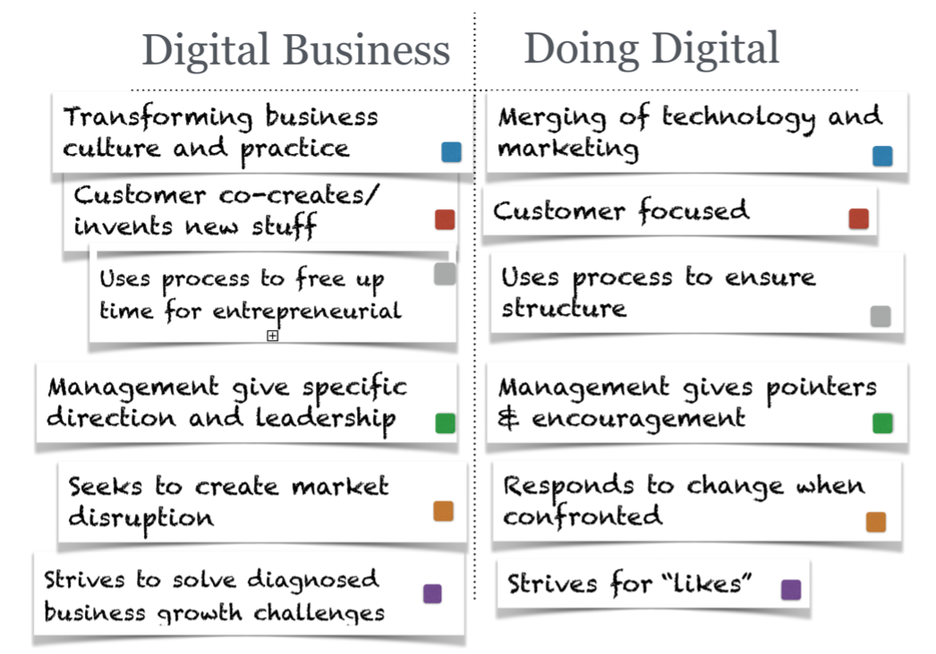
Q&A: “Doing Digital” vs True DT
Understand that competitive advantage is not created by technology, it is created by leaders and the strategies they devise. Technology is most often the enabler, rarely the differentiator.
Source: A Step-by-Step Guide
to Digital Transformation by
Niall McKeown / ionology
Notes:
https://www.slideshare.net/niallmckeown/digital-transformation-45738266

Slide 33
Q&A: Test Your Digital Strategy
Profoundly Compelling
Driving Real Business Value
Customer-Centric
☑ Positively Affirming
☑ Clearly Actionable
The toughest challenge in digital transformation is not to define a strategy, but rather to make it tangible and actionable.
Jane McConnell

Slide 34
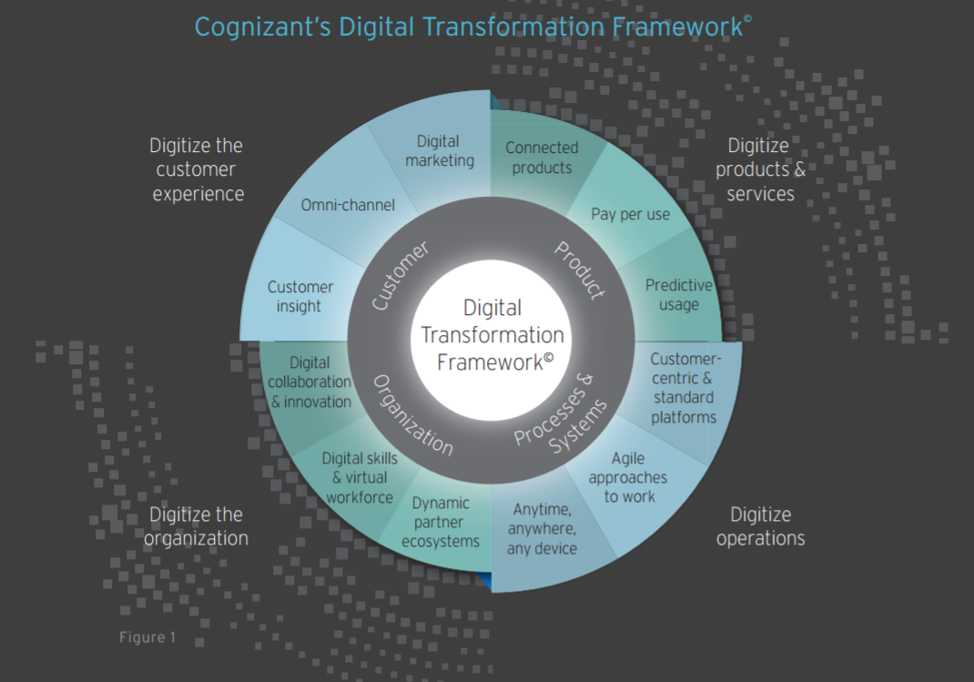
Q&A: How long should DT take?
How long will it take your company / organization to change all of these?
Source: The New Reality 20 Ways to Achieve Digital Transformation &
Cognizant’s Digital Transformation Framework
Notes:
http://thenewreality.info/poster
https://www.cognizant.com/InsightsWhitepapers/a-framework-for-digital-business-transformation-codex-1048.pdf

Slide 35
Q&A: How much should DT cost?
Frank Blake, CEO of The Home Depot, shared a plan to spend $300 million on digital technology so customers could order on their phones and pick up in the store. Six months later, he raised that to
$1.5 billion to cover the cost of new distribution centers and an overhauled fulfillment process… [2% of annual costs]
Digital transformation will tip from experiences to operations.
Transformation budgets will edge up into the billions.
Brands will finally build holistic customer experiences that transcend touchpoints.
Source: Forrester Predictions: In 2017, Digital Transformation Budgets Will Top The Billion-Dollar Bar
Notes:
I think 2% of operational costs is a good target to start with… it will be more… but 2% is all you’ll probably be willing to invest until you see real results
https://www.forbes.com/sites/forrester/2016/11/02/forrester-predictions-in-2017-digital-transformation-budgets-will-top-the-billion-dollar-bar/#8422c7f21c87

