Slide 1
Creating
Truly Innovative Experiences
Adam Kruszynski / www.adamoutsidethebox.com
Director of Digital @ Revolve
HPX Digital 2013 @ Atlantica Hotel in Halifax

Slide 2
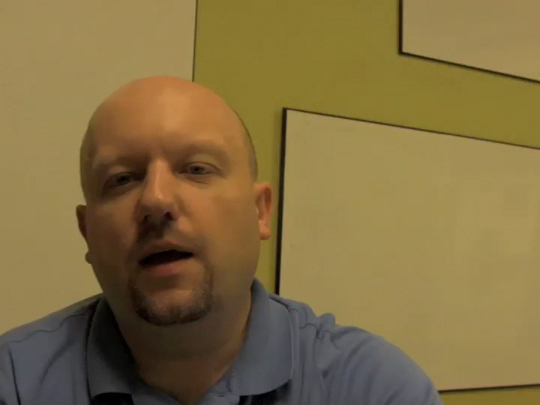
Notes:
I’ll share 3 things about me / not going to bore you with my experience… and let content stand for itself
I’m a geek… grew up around computers & coding since I was 7, before atari or comodore, before flopies or even tape drives
I’m a polidadian… Polish Canadian
I’m an idiot… not just any idiot… a very specific type of idiot… I’m the idiot that volunteers for crazy projects

Slide 3
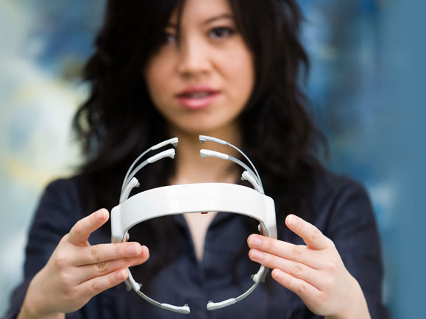
Where is this all going?
Tan Le @ Ted.com
EPOC Headset
Translates thoughts
into computer input
The Road Ahead
Notes:
The problem: How can we keep up and create innovative experiences with digital industry and tech changing so quickly.
Question: Who knows this device? Brain Wave Readying Headset @ Tan Le (not bald man hair stimulator)
The solution / topic: A single tech-agnostic framework for just that… creating innovative experiences.

Slide 4

The Big
???
Notes:
Examples I’ll use to demonstrate points are from my work experience
But real credit is due to those who really created them
And the clients who had the courage to take the leap of faith

Slide 5
7 ½ Steps to Create
Truly Innovative Experiences
Notes:
Let’s start with a single framework
No matter what technology now or in future
Innovating / doing pioneering work is very challenging

Slide 6
Know What You Want
Choreograph User Journey
Storyboard Each Experience
Build a Functional Prototype
Build the Experience
Test with Real Users
Execute & Measure
½ Expect it to change, often in ways
you could not even imagine…
Notes:
Quick overview
Session is done
Let’s deep dive

Slide 7
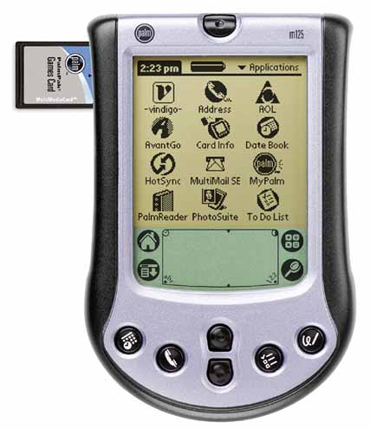
Released in 2001
8MB Internal RAM
Step 1: Know What You Want
Notes:
Question: What year was this device released in North America and how much internal memory did it have?
Know what you want / establish insight driven success goals
Example: Autoshow Mobile CRM for Nissan… First year we created a digital version of a paper process but made no impact on sales
Shout out: Too many people to mention
Crazy client: Nissan

Slide 8
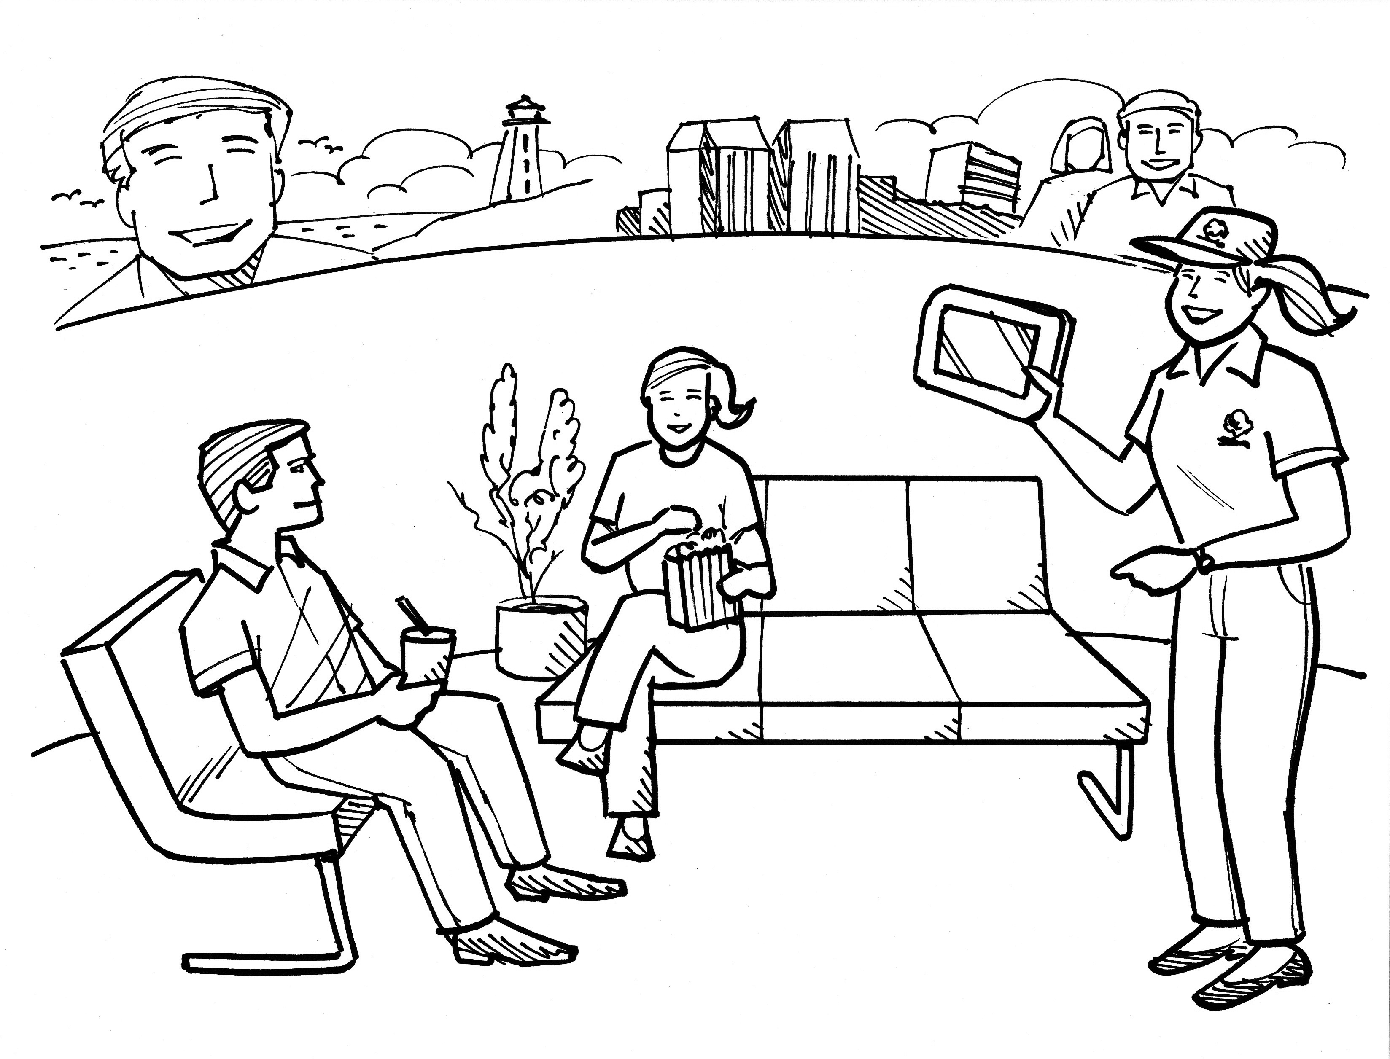
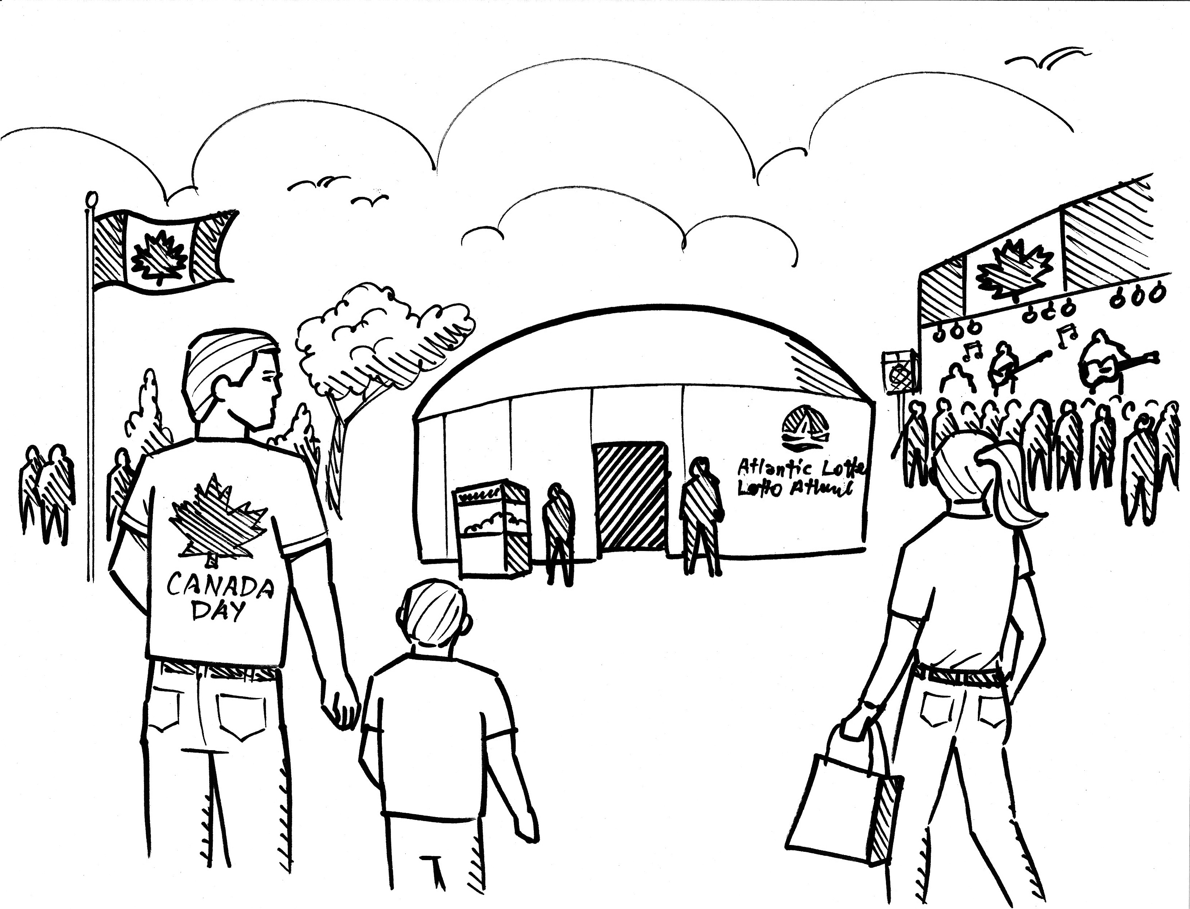
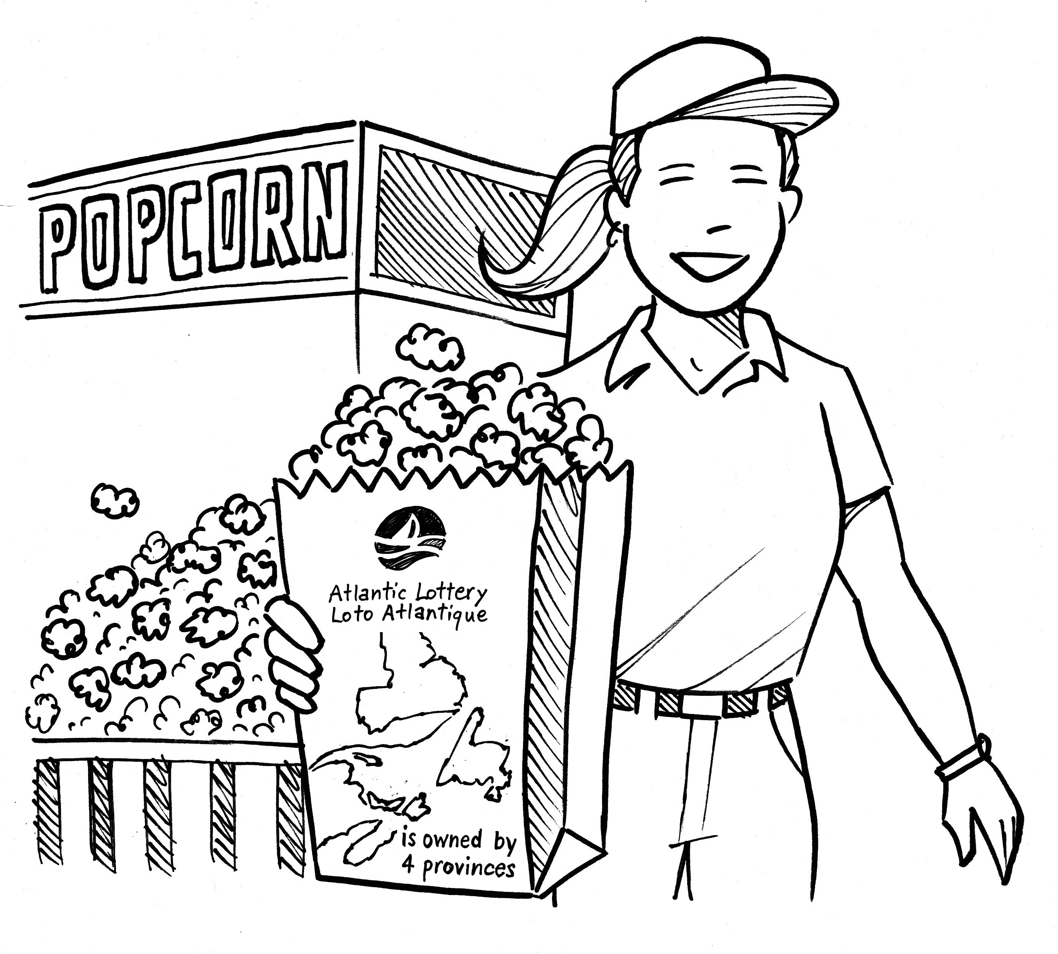
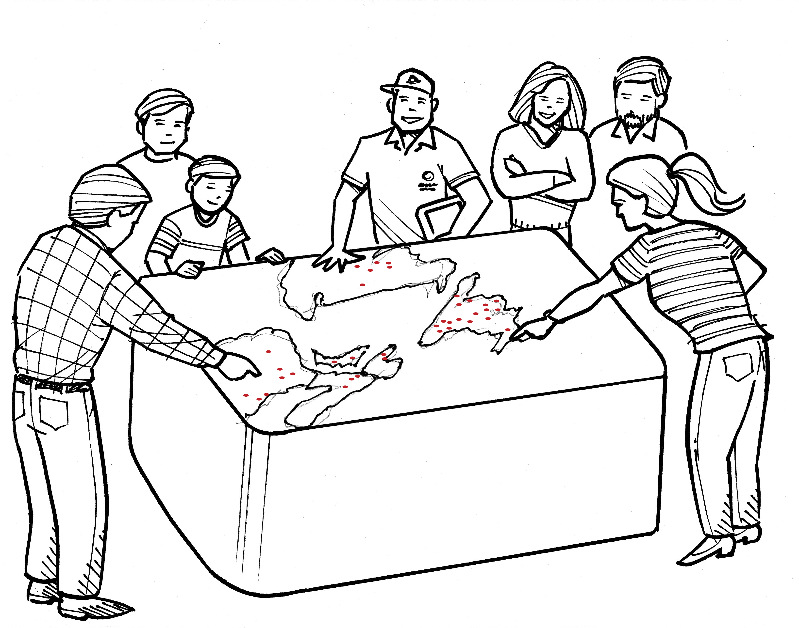
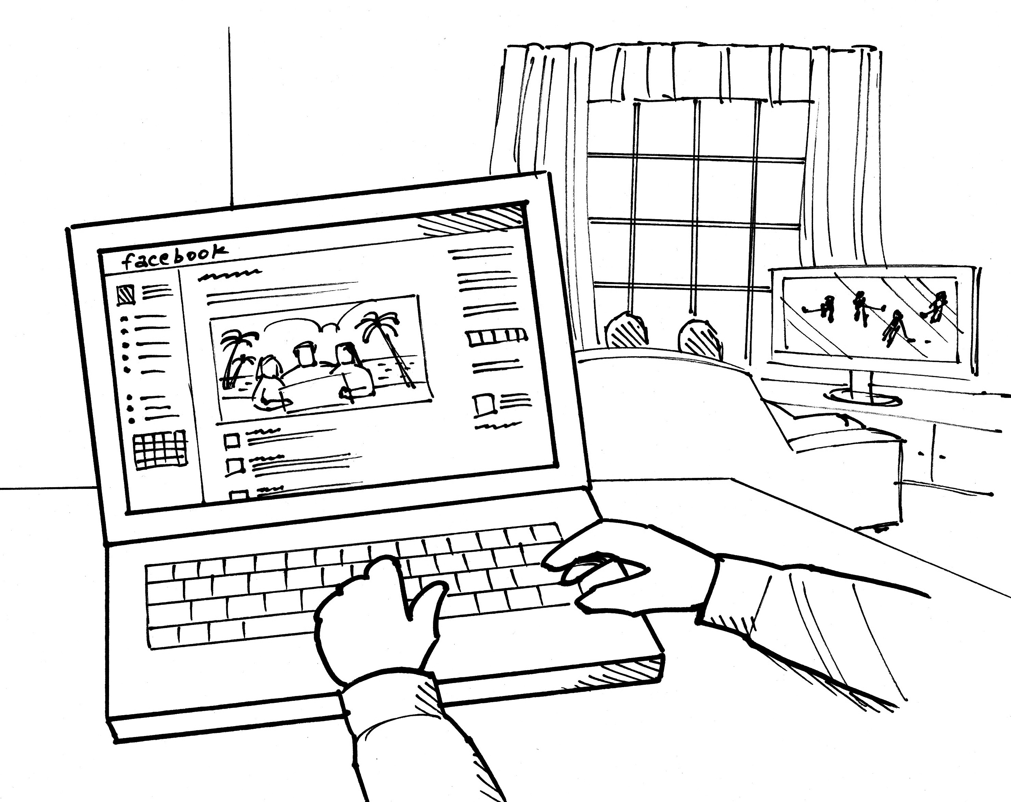
Step 2: Choreograph User Journey
Notes:
Map out / draw the user journey... start to end… think about this as a movie script
Understand the context, the motivation, and the role for the specific experience you are creating
Example: AL Dome / Making people understand and care about where Lottery money goes
Shout out: Kelly Devoe for illustrations, Ad Dispatch and Alexi Prizeau for digital experiences
Crazy client: Atlantic Lottery… have you done anything like this before? You really want all stations to be digital?

Slide 9
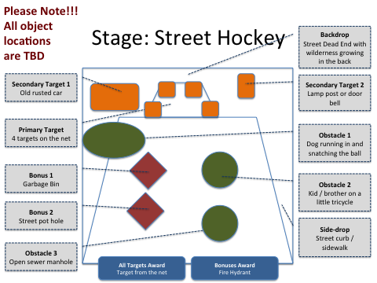
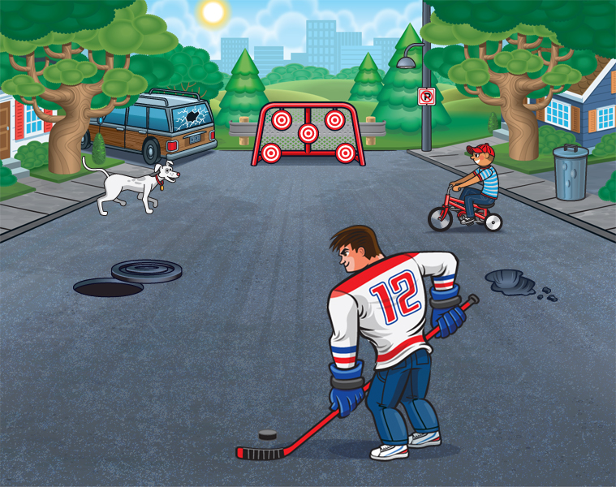
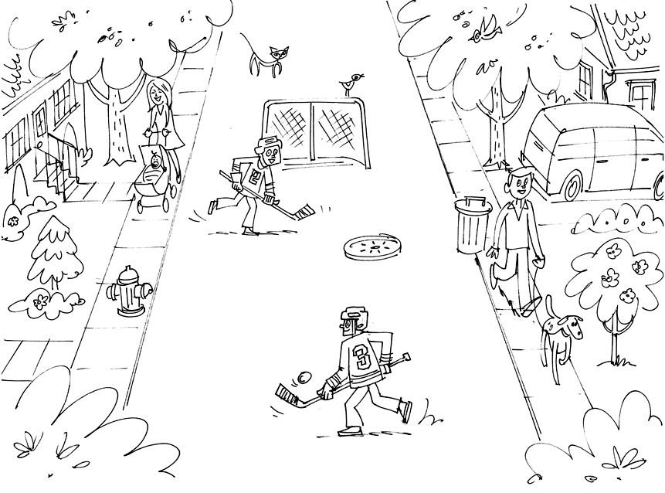
Step 3: Storyboard Each Experience
TIMBER MART SharpShooter Game
Contest for Junior Hockey Associations
Facebook, iOS, & Android
Notes:
Next step: Storyboard each experience… think of this as a specific movie scene storyboard
Resist the urge to jump into technology decisions
Question / Example: Do you recognize this project / TIMBER MART SharpShooter
Shout out to: Jason Munger (illustrations) and HPX’s own Kris McCann for (game build)
Crazy client: Timbermart… you wanna do what? We sell lumber and hardware?

Slide 10
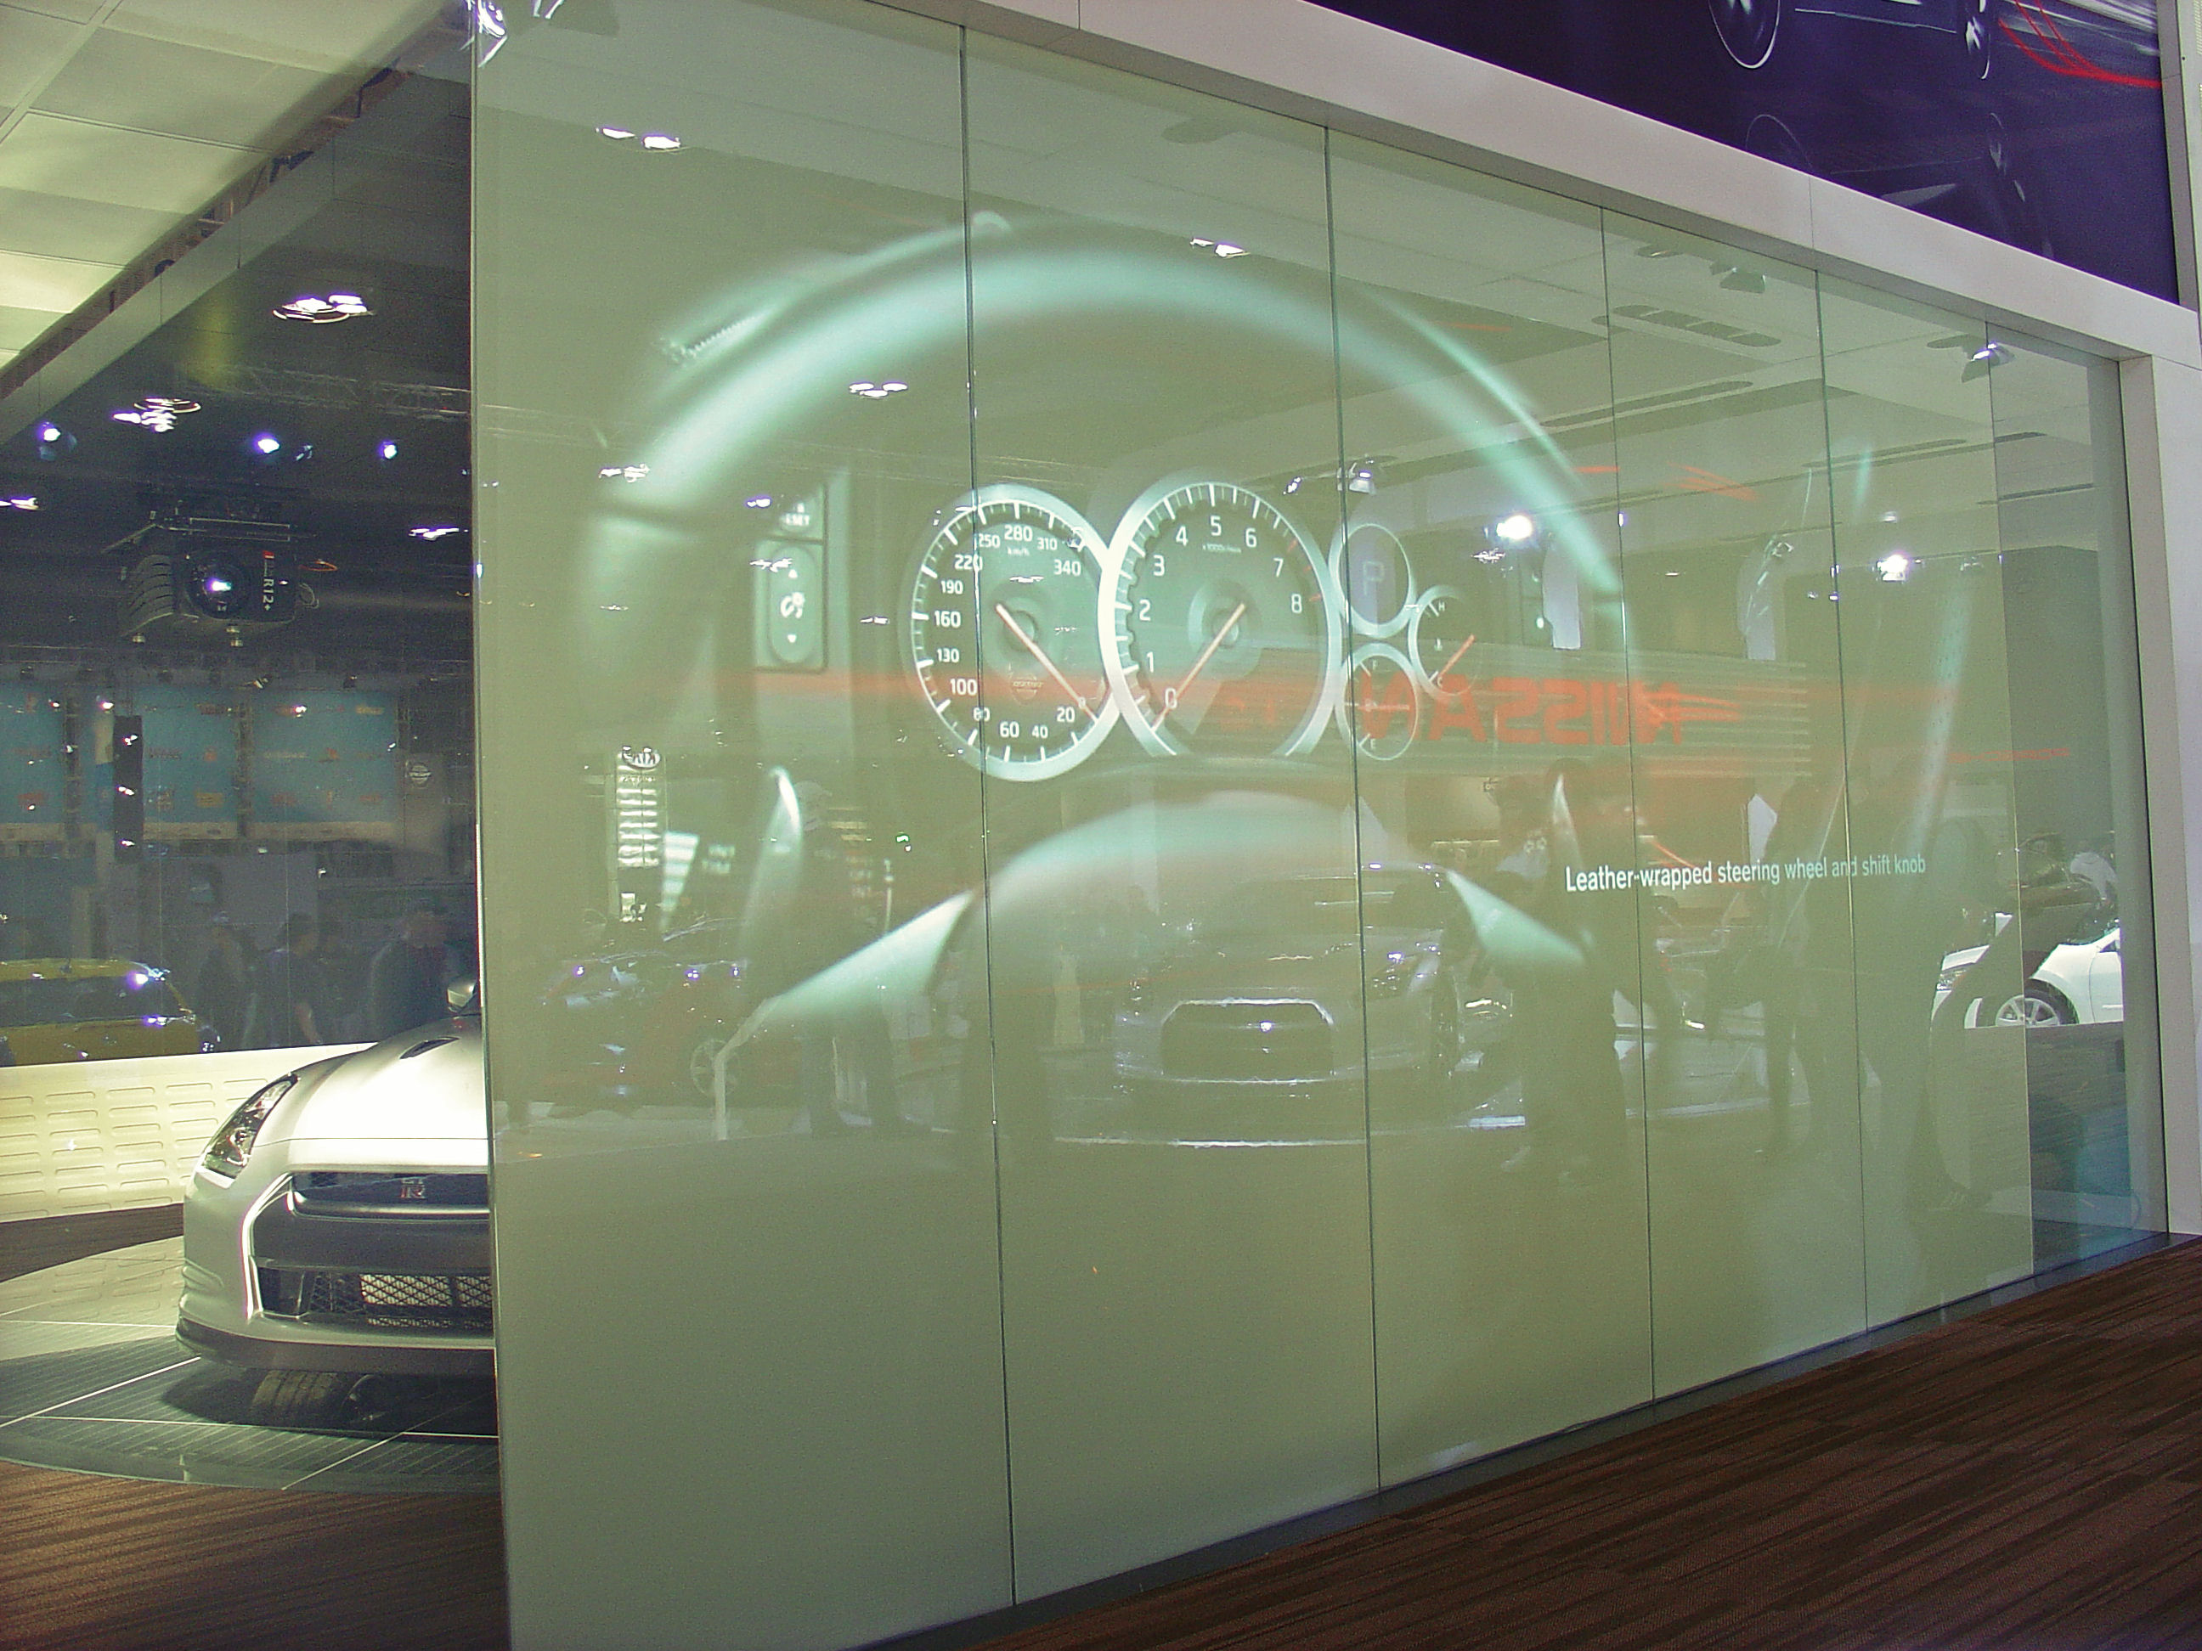
Step 4: Build a Functional Prototype
Notes:
Next build a functional prototype to identify and overcome unknowns / risk
Simplify the experience to core components / Develop working concept
Example: Nissan GTR Autoshow 7+1 using Switch Wall
Shout out: Alexi Parizeau and KPG
Crazy client: Nissan…

Slide 11
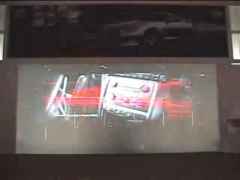

Slide 12
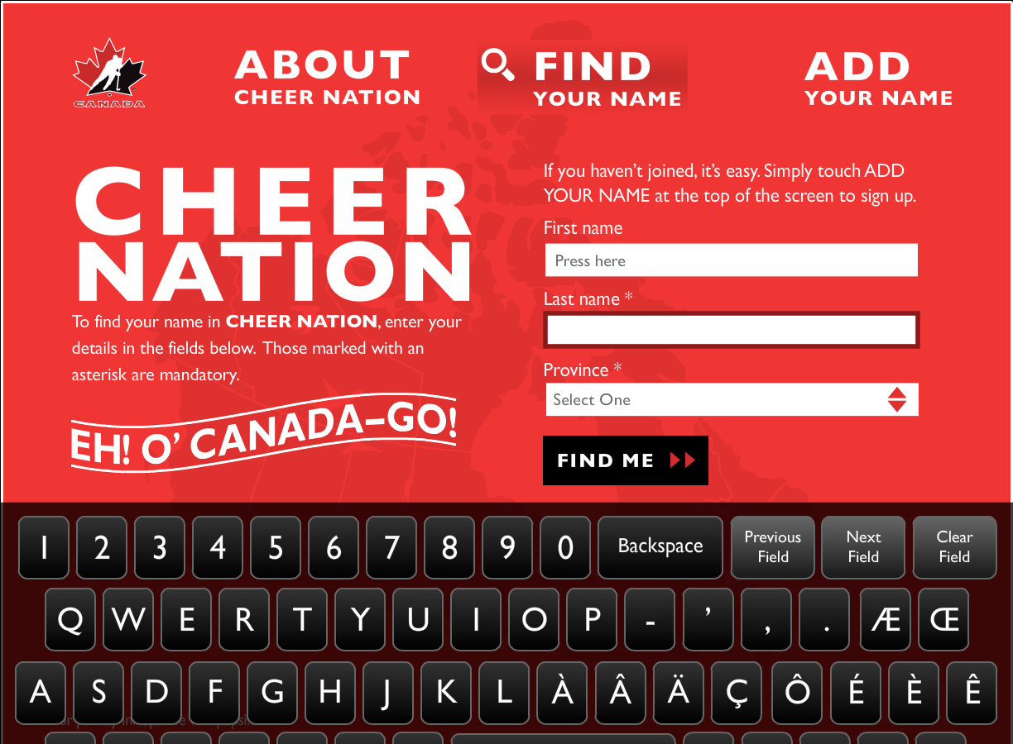
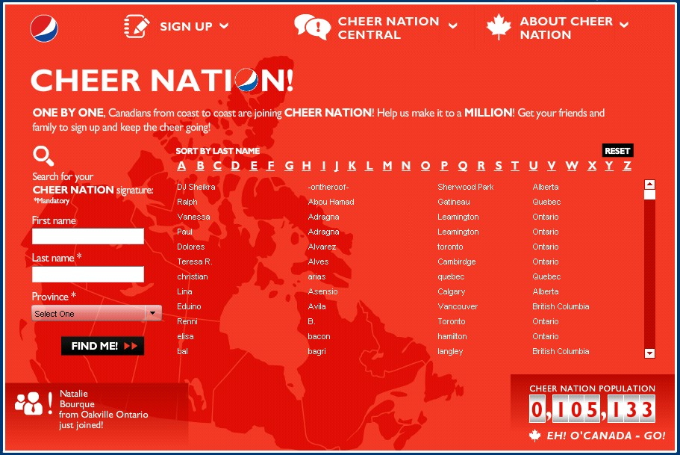
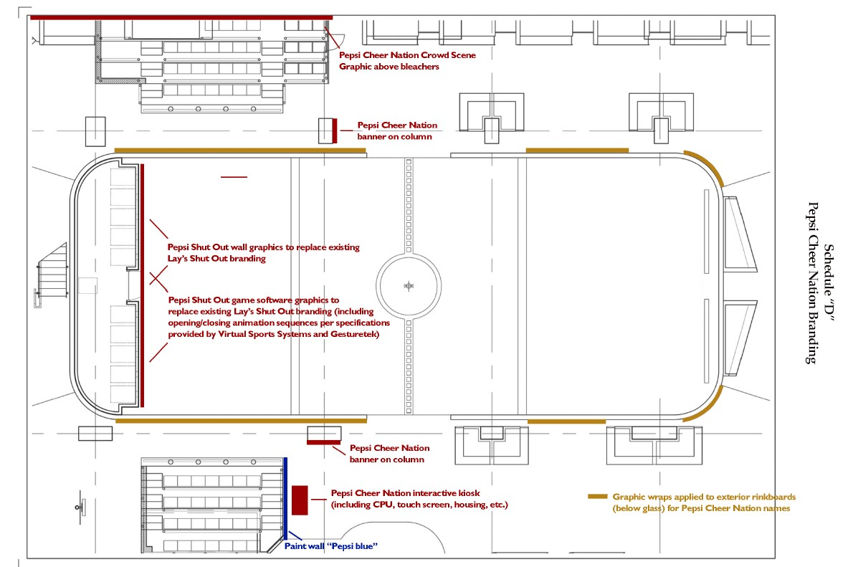
Step 5: Build the Experience
Notes:
Build in pieces so you can better track progress and overages (iterative process)
The overall user journey is what matters / back to success goals... Don’t over focus on just this experience
Example: Pepsi Cheer @ Toronto HHOF… videos, game experiences, kiosks, how to find your name, signage, context of HHOF
Knowing what you want… Not about telling Canadians what their hockey cheer should be?... it was about keeping market share when Coke owned Vancouver Olympics.
Shout out: Rachel Ma & Jovan Alleyne from Toronto
Crazy client: Pepsi

Slide 13
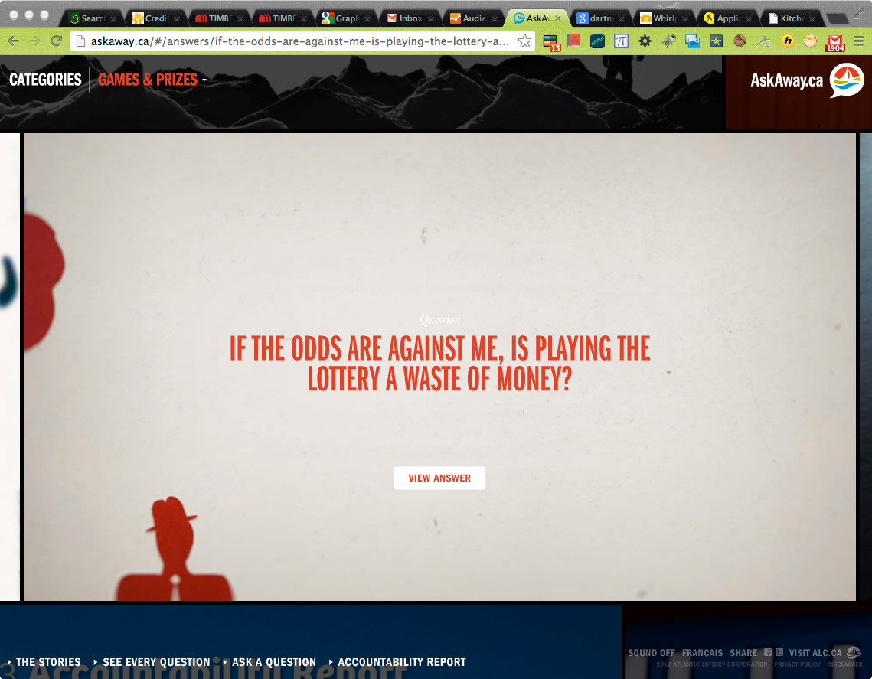
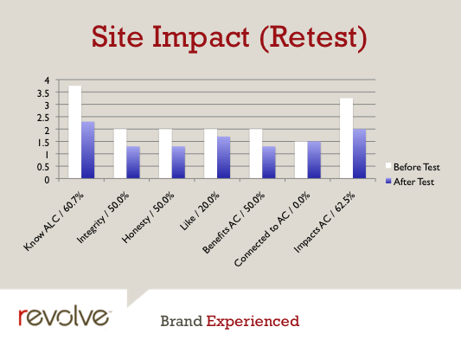
Step 6: Test With Real Users
Notes:
Next test against goals (not just functionality) with real users
Observe true experiences... success you wanted?
Example: AL Corp Rep / testing AskAway.ca
Shout Out: I did the user testing… but it should have been Mike Downs, great usability guy
Crazy Client: AL… we want to build a website where the public can ask you anything they want… and you answer honestly and transparently… by staff responsible… actually they already wanted to be transparent we just showed them how

Slide 14
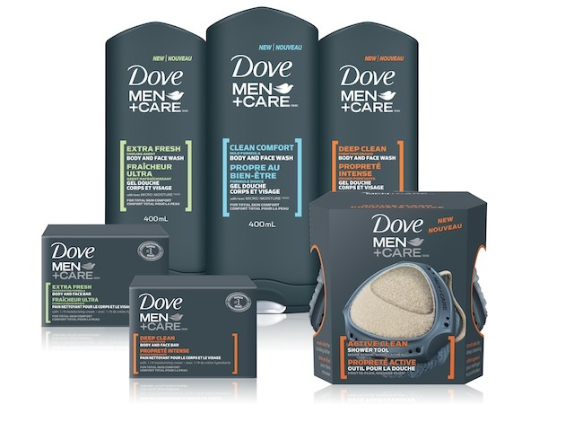
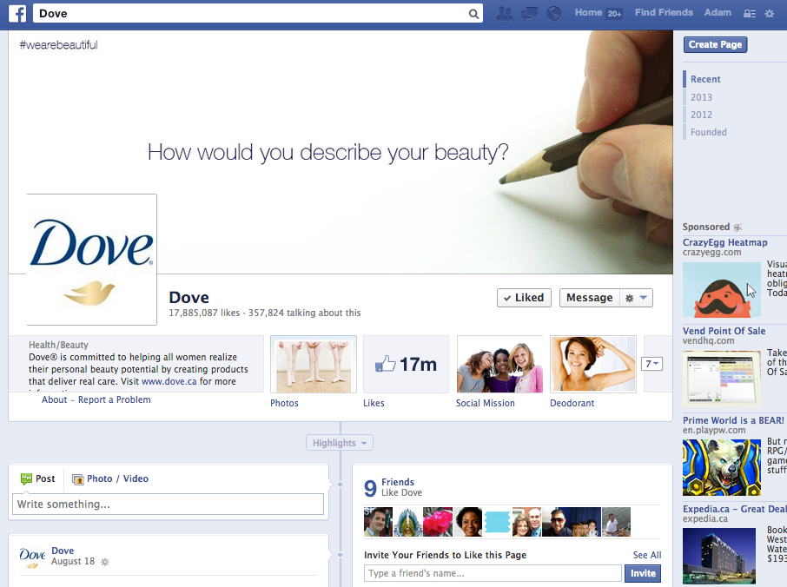
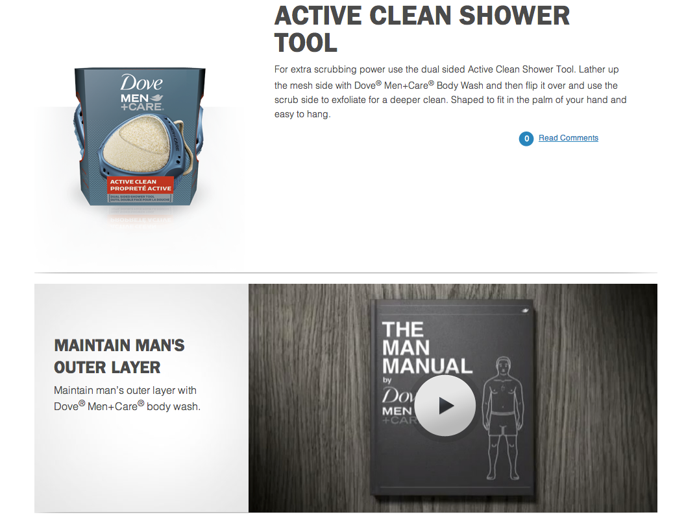
Step 7: Execute and Measure
Notes:
Execute and measure… they go together… so much to learn from innovative product launches
Example / Question: Guess which of the Dove Man Care products was most popular?
Getting pass default stats (e.g. visits) to understand success / back to Know what you want
Shout out: Too many to mention
Crazy client: Dove

Slide 15

Step 7.5: Expect it to change
in ways you could not imagine
Notes:
Expect to change… dealing with people and people are unpredictable
Example: coming to Halifax to grow Digital practice @ Revolve
It’s not about reaching a compromise about my vision and someone else’s… it’s about finding a new vision greater than both combined
Crazy client: Phil / Nelson / Matt, partners at Revolve

Slide 16
Know What You Want
Choreograph User Journey
Storyboard Each Experience
Build a Functional Prototype
Build the Experience
Test with Real Users
Execute & Measure
½ Expect it to change, often in ways
you could not even imagine…
What am I missing here?
Notes:
Quick overview
Session is done
Let’s deep dive

Slide 17
Ideation is not a step, it’s a constant
Notes:
Did I miss a step of brainstorming / ideation?
Absolutely

Slide 18
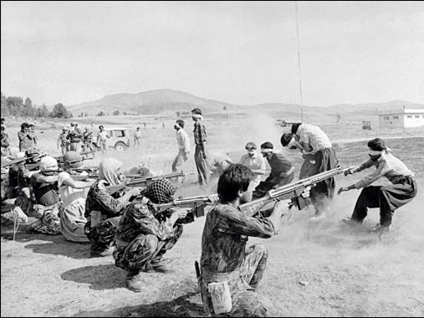
Typical Brainstorms
Ideation
Idea Execution
 | Idea A | Idea B | Idea C | Idea D | Idea E | Idea F
Problem 1 | ☑ | ☒ | ☒ | ☑ | ☑ | ☒
Problem 2 | ☑ | ☒ | ☑ | ☑ | ☒ | ☒
Problem 3 | ☒ | ☒ | ☒ | ☒ | ☒ | ☑
Problem 4 | ☒ | ☒ | ☑ | ☑ | ☒ | ☒
Problem 5 | ☒ | ☒ | ☒ | ☑ | ☑ | ☑
Problem 6 | ☑ | ☑ | ☑ | ☑ | ☑ | ☑
Problem 7 | ☑ | ☑ | ☑ | ☑ | ☑ | ☑
No Real Winners!

Slide 19
True Ideation Process
1. Simplify Requirements
5. Pilot & User
Test Your Ideas
3. Compare
Not Eliminate
☑
☑
☑
☑
☑
☑
☑
☑
☑
2. Ideate Together
4. Amplify Your
Best Ideas

Slide 20
3 Laws of Innovation with New Technology
Notes:
3 laws to help you direct innovation, not limit it
To overcome risks without compromising the innovative experience
Sometimes laws are meant to be broken

Slide 21
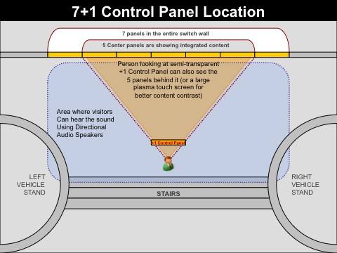
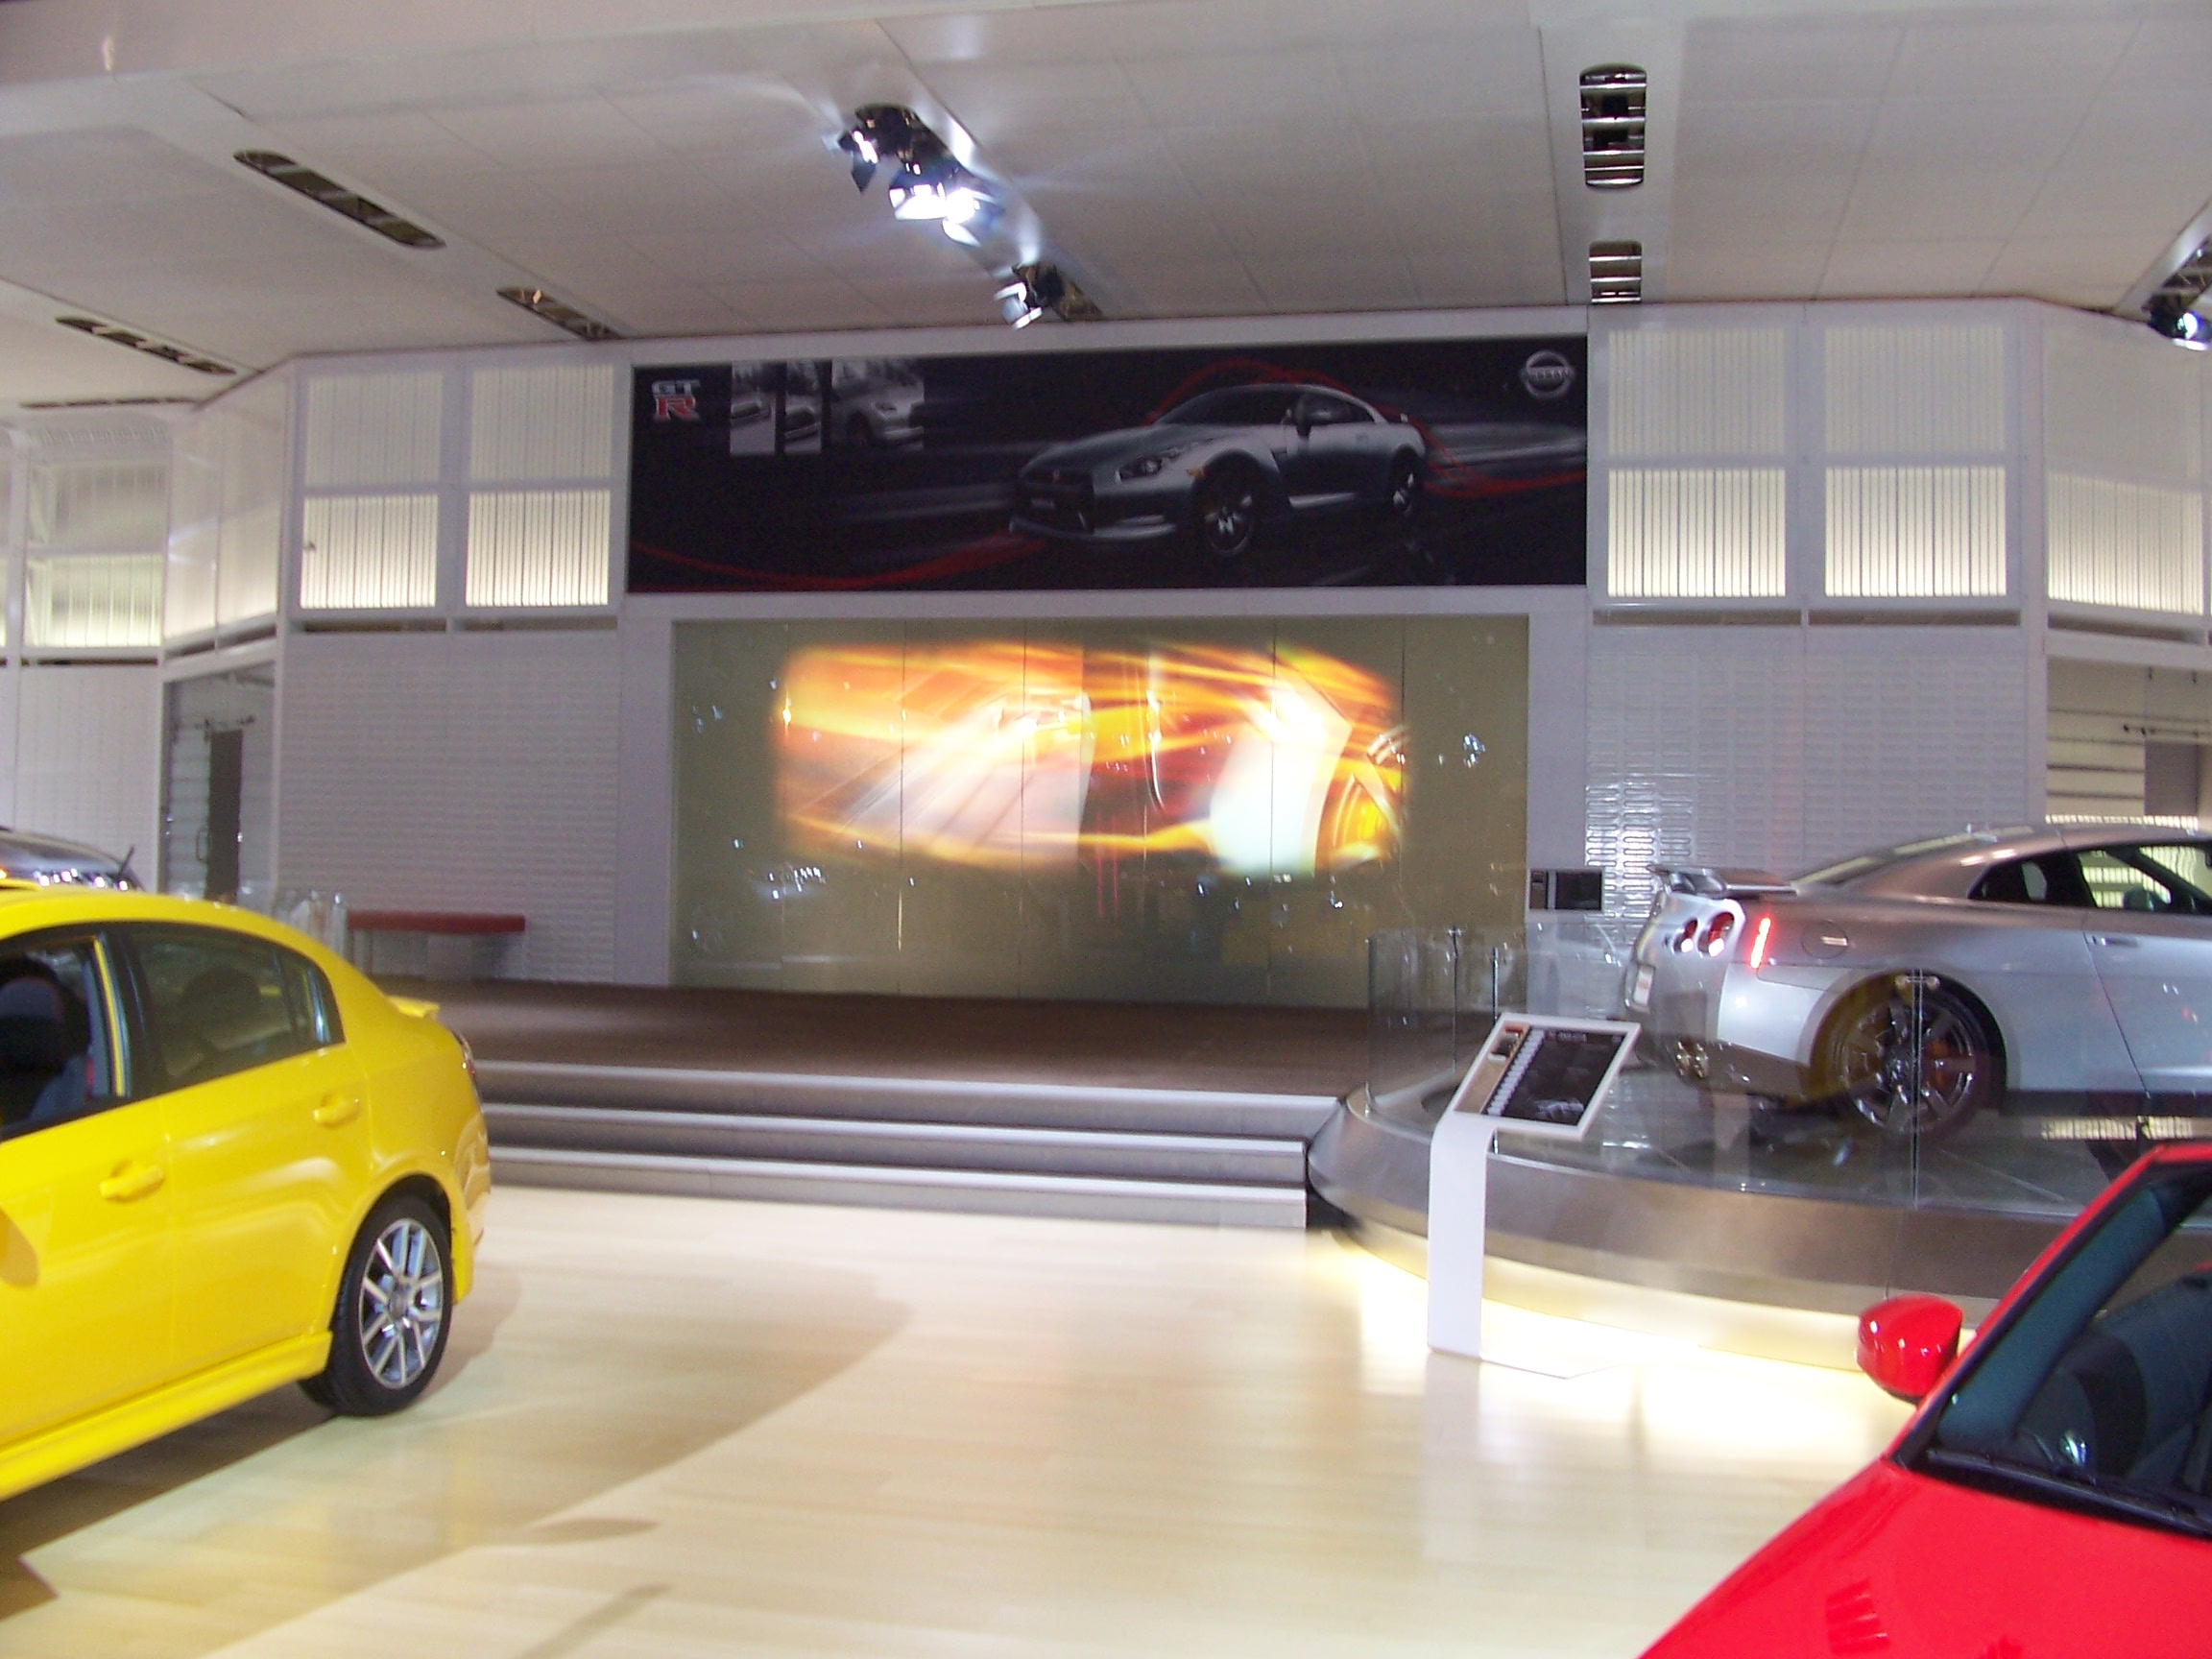
Law #1: Choose Simple & Powerful
Notes:
Choose Simple & Powerful vs Cool but Complex
Risk: The message gets lost in complexity and user frustration
Focus on the core of the experience and amplify it into something great
Example: Nissan Autoshow GTR 7 + 1 Experience original vs final vision

Slide 22
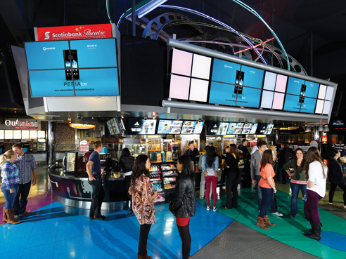
Law #2: Use Natural Behaviour
Notes:
Example: Scene card kiosk / mobile registration at Cineplex cinemas
Natural intuitive behaviours over learned behaviours... easier to achieve by user
It doesn’t matter if you think it’s natural… do user testing on prototype to find out

Slide 23
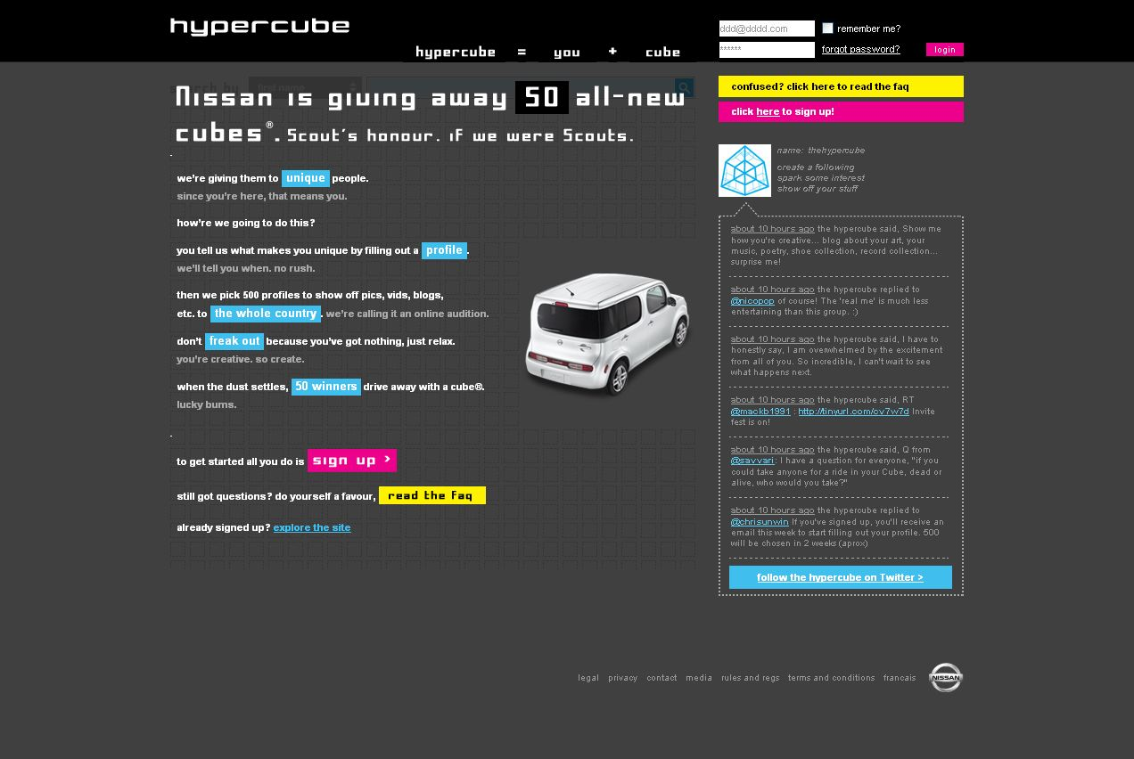
Law #3: Rely on Native Integration
Notes:
Native, not custom methods of integrating... Instead of forcing / hacking your way through…
Use methods the tech provider / manufacturer intended, will expand, and will continue supporting
Example: Nissan Cube Launch via hypercube / social media integration

Slide 24

Thank You + Surprise + Questions
Adam Kruszynski
Director of Digital @ Revolve
Co-Chair @ AIM Conference
LinkedIn: ca.linkedin.com/in/kruszynskiadam/
Twitter: @adamoutsidedbox
Website: www.adamoutsidethebox.com
(also has copy of this deck)
Surprise: You are welcome to download my digital book for FREE (iTunes / PDF)
www.adamoutsidethebox.com/writing/
Notes:
Thank you
Get copy of this deck on my website & LinkedIn
Surprise free book… no I’m not selling it / just sharing it / totally free
Questions?

Slide 25
Adam Outside The Box
Security
Safety
Familiarity
Learning
Adventure
Growth
Ability to Change
Strategy | Innovation | Management | Communication
Notes:
Thanks for having me here HPX Digital
I am Adam Outside the Box. Most people find safety in theirs boxes. I like to live outside of them.
Variety of backgrounds including marketing, web, research, sociology, teaching, writing, speaking, technology

